Slide 1
CEN 3078 Computer Security
Midterm - Review

Slide 2
Network and application layers – security concepts
Packet sniffing and spoofing
Intrusion detection systems
Legal and ethical issues
Module 1

Slide 3
Model of Internet Layers for User/Device Communications

Slide 4
TCP/IP Communication

Slide 5
TCP/IP Communication (2)

Slide 6

Types of Ethical Hackers
White Hat Hacker
Do not intend to harm the system or organization but they so, officially to penetrate and locate the vulnerabilities, providing to fix them and ensure safety
Black Hat Hacker
They are non-ethical hackers performing hacking to fulfill their selfish intentions to collect monetary benefits
Grey Hat Hacker
Combination of white and black – they hack without any malicious intent for fun; don’t use approval from a targeted organization and publicly disclose any vulnerability

Slide 7
Basic Security Terminology
Devices:
Firewall
Filters network traffic
Proxy server
Disguises IP address of internal host
Intrusion Detection System (IDS)
Monitors traffic, looking for attempted attacks
Activities:
Authentication
Auditing

Slide 8

Exercise: Act during an Intrusion
Suppose you observe that your PC is responding very slowly to information requests from the net. And then you further observe that your network gateway shows high levels of network activity, even though you have closed your e-mail client, Web browser, and other programs that access the net.
What types of malware could cause these symptoms?
How might the malware have gained access to your system?
What steps can you take to check whether this has occurred?
If you do identify malware on your PC, how can you restore it to safe operation?

Slide 9
In-Class Exercise: Act during an Intrusion
What types of malware could cause these symptoms?
Virus, Worm
How might the malware have gained access to your system?
Phishing attacks using malicious email messages that activate the virus or worms by using a web link pointing to a malware download or carrying malicious attachments
What steps can you take to check whether this has occurred?
Refer to your anti-virus software logs
Use a traffic network analyzer, like Wireshark, and scan the network traffic for a period of time to possibly determine the type of traffic being generated by the PC, the destination, and also the service that is generating that traffic

Slide 10
In-Class Exercise: Act during an Intrusion
d) If you do identify malware on your PC, how can you restore it to safe operation?
Isolate the machine from any network connections
Attempt to create a backup of the data, although the backup will contain infected files, at least data will be saved for future cleaning
If possible, completely rebuild the system and recover the data from the most recent backup that is considered free from malware
If no backups are available then try to clean the system using an anti-virus package or other data recovery tools
Moral: Have a plan and know your Risks; Consider Cyber Insurance purchase and follow Incident Response best practices…

Slide 11
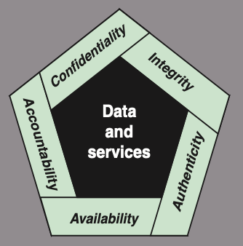
Cyber Security Definition
NIST 7298 Report defines the term cybersecurity as follows:
“Measures and controls that ensure confidentiality, integrity, and availability of information system assets including hardware, software, firmware, and information being processed, stored, and communicated.”
1. What assets do we need to protect?
2. How are those assets threatened?
3. What can we do to counter those threats?
NIST standard FIPS 199 (Standards for Security Categorization of Federal Information and Information Systems)

Slide 12
Key Security Concepts
Confidentiality
Integrity
Availability
Preserving authorized restrictions on information access and disclosure, including means for protecting personal privacy and proprietary information
Loss of confidentiality is the unauthorized disclosure of
information
Guarding against improper information modification or destruction, including ensuring information nonrepudiation and authenticity
Loss of integrity is the unauthorized modification or destruction of information
Ensuring timely and reliable access to and use of information
Loss of availability is the disruption of access to or use of information or an information system

Slide 13
Related CIA Triad Definitions – from Information Assurance Perspective
Confidentiality: This term covers two related concepts:
Data confidentiality: Assures that private or confidential information is not made available or disclosed to unauthorized individuals
Privacy: Assures that individuals control or influence what information related to them may be collected and stored and by whom and to whom that information may be disclosed
Integrity: This term covers two related concepts:
Data integrity: Assures that information and programs are changed only in a specified and authorized manner
System integrity: Assures that a system performs its intended function in an unimpaired manner, free from deliberate or inadvertent unauthorized manipulation of the system
Availability: Assures that systems work promptly and service is not denied to authorized users
Notes:
CREATE A STORY OF A PERSON WHOSE EMAIL IS HACKED, THEN TWITTER IS HACKED WITH REPULSIVE MESSAGES, FACEBOOK FRIENDS BLOCKED, AND THEN BANK INFO IS CHANGED AND THEN EMAIL ACCESS IS DENIED – WRITE ALL DEFINITIONS ON BOARD AND STRIKE OUT TERMS E.G., ADVERSARY, THREAT, ATTACK, ETC.

Slide 14
Application Security vs. Network Security
Application Security
Preservation of confidentiality, integrity, and availability of application information
Other properties such as authenticity, accountability, non-repudiation, and reliability can also be involved
Network Security
Protection of networks and their services from unauthorized modification, destruction, or disclosure
Provision of assurance that the network performs its critical function correctly and that there are no harmful side effects

Slide 15
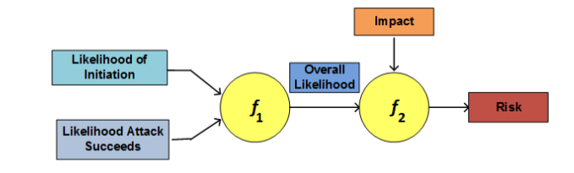
Security Concepts and Relationships (from RFC 2828, Internet Security Glossary)
Adversary (threat agent)
Individual, group, organization, or government that conducts or has the intent to conduct detrimental activities
Attack
Any kind of malicious activity that attempts to collect, disrupt, deny, degrade, or destroy information system resources or the information itself
Countermeasure
A device or techniques that has as its objective the impairment of the operational effectiveness of undesirable or adversarial activity
Aims to prevent espionage, sabotage, theft, or unauthorized access to or use of sensitive information or information systems
Risk
A measure of the extent to which an entity is threatened by a potential circumstance or event, and typically a function of: (i) the adverse impacts that would arise if the circumstance or event occurs; and (ii) the likelihood of occurrence

Slide 16
Security Concepts and Relationships (2) (from RFC 2828, Internet Security Glossary)
Security Policy
A set of criteria for the provision of security services; It defines and constrains the activities of a data processing facility in order to maintain a condition of security for systems and data.
System Resource (Asset – Hardware, Software, Data, Network)
A major application, general support system, high impact program, physical plant, mission critical system, personnel, equipment, or a logically related group of systems
Threat
Any circumstance or event with the potential to adversely impact/harm: organizational operations (including mission, functions, image, or reputation), organizational assets, individuals, other organizations, or the Nation through an information system – via unauthorized access, destruction, disclosure, modification of information, and/or denial of service
Vulnerability
Flaw or weakness within: an information system, system security procedures, internal controls, or implementation that could be exploited or triggered by a threat source
Basically, a threat is a possible danger that might exploit a vulnerability…

Slide 17
Vulnerabilities, Threats and Attacks
Categories of vulnerabilities
Corrupted (loss of integrity)
Leaky (loss of confidentiality)
Unavailable or very slow (loss of availability)
Threats
Capable of exploiting vulnerabilities
Represent potential security harm to an asset
Attacks (threats carried out)
Passive – attempt to learn or make use of information from the system that does not affect system resources
Active – attempt to alter system resources or affect their operation
Insider – initiated by an entity inside the security parameter
Outsider – initiated from outside the perimeter

Slide 18
Levels of Impact
Low
The loss could be expected to have a limited adverse effect on organizational operations, organizational assets, or individuals
Moderate
The loss could be expected to have a serious adverse effect on organizational operations, organizational assets, or individuals
High
The loss could be expected to have a severe or catastrophic adverse effect on organizational operations, organizational assets, or individuals
(i) organization functions are noticeably reduced; (ii) minor damage to assets; (iii) minor financial loss; or (iv) minor harm to individuals
(i) organization functions are significantly reduced; (ii) significant assets damage; (iii) significant financial loss; or (iv) significant but not life-threatening individuals harm
(i) organization functions are severely disrupted; (ii) major damage to assets; (iii) catastrophic financial loss; or (iv) individual loss of life or life-threatening injuries

Slide 19
In-Class Exercise: How to Secure Linux OS?
To avoid malicious compromise of system resources, following issues need to be addressed:
Use strong passwords – lock account if multiple login failures
Install only the required software packages
Do you need Apache?
Setup access lists for services (i.e., host firewall)
Regularly patch the OS
Check listening ports and verify if those are required
Use “netstat” or even an Intrusion Detection System (IDS) for monitoring
Run only required system services
Use “chkconfig” to list all services started at bootup
Avoid telnet, rlogin and rsh – use scp/sftp instead
Secure remote access
Secure NFS if sharing files over network
For more details - http://www.puschitz.com/SecuringLinux.shtml

Slide 20
Threats on Assets
An online drive is compromised
After a successful attack (e.g., Sony Hack)
An unauthorized copy of software is made - or -
Licenses are used without permission

Slide 21
Importance of Cybersecurity for Manufacturers
Manufacturing businesses are increasing online for operations
Web, Cloud Computing, Internet-of-Things, Big Data
Manufacturers are unfortunately a frequent target of hackers and attackers
According to a report from the U.S. Department for Homeland Security, manufacturing is the second highest industry with the most reported cyber attacks, only subsequent to the energy sector
According to a report by NTT Security, the manufacturing industry was the most heavily targeted industry during Q2 2017, accounting for 34% of all documented attack activity
A Kaspersky Lab Survey of IT managers published in Virus News also found that “21 percent of manufacturers suffered a loss of intellectual property (IP) within the past year”
https://www.nist.gov/blogs/manufacturing-innovation-blog/cybersecurity-protecting-manufacturing-technology-and-innovation

Slide 22
In-Class Exercise: Create a survey for a small-business company
Create a survey questionnaire that will help a cybersecurity expert to assist a manufacturing/utility enterprise in becoming aware of their current cyber security posture and help them in:
Defending their company’s vital data and information
Preventing theft or damage to company infrastructure, equipment and systems
Avoiding major disruptions to operations and the delivery of products
Protecting employee’s personal information
Shielding the company from negative publicity
Planning IT budgets and policies with adequate cyber incident response
Discuss potential improvements in cyber attack threat detection and mitigation strategies that result in benefits in terms of:
increased productivity, cost savings and reduced risk

Slide 23
Small Business Response Exercise
Assume you are speaking to a small business enterprise
- <<Name>>
Q1) Important assets in your enterprise that are networked internally or with an external site
a) Do you use industrial equipment that is connected to the Internet? Yes / No
b) Are there machines connected to computers with industry-standard/paid software licenses? Yes / No
c) Do you store and share business-related data using cloud platforms? Yes / No
d) Do you operate a private data center/server with network equipment? Yes / No
e) Briefly describe any other relevant information pertaining to Q1:

Slide 24
Small Business Response Exercise (2)
Q2) Potential cyber attack threats and the risks associated with compromise of valuable assets
a) Are you concerned about loss of data confidentiality due to undesired information exposure? Yes / No
b) Are you concerned about data integrity because of data corruption by human/machine? Yes / No
c) Are you concerned of loss of services or infrastructure that makes data inaccessible? Yes / No
d) Briefly describe any other relevant information pertaining to Q2:

Slide 25
Small Business Response Exercise (3)
Q3) Solutions adopted to address cyber security threats and the risks associated with compromise of valuable assets
a) Do you use commercial or open-source software or network appliances for cyber security? Yes / No
b) Do you manage network firewalls or role-based access control policies? Yes / No
c) Do you have a process to monitor and prevent potential cyber intrusion detection? Yes / No
d) Do you need the cyber security solutions to be compliant for external security audits? Yes / No
e) Briefly describe any other relevant information pertaining to Q3:

Slide 26
Small Business Response Exercise (4)
Q4) Cyber security posture and potential of impact limits your workers day-to-day productivity
a) Do you have a cyber security posture related design document? Yes / No
b) Do you have a budget allocated for cyber security related business cost? Yes / No
c) Are you satisfied with the effort and/or $$ on cyber security? Yes / No
d) Briefly describe any other relevant information pertaining to Q4:

Slide 27
Network and application layers – security concepts
Packet sniffing and spoofing
Intrusion detection systems
Legal and ethical issues
Module 1

Slide 28
Passive and Active Attacks
Passive Attack
Active Attack
Attempts to learn or make use of information from the system but does not affect system resources
Hard to detect (no alteration)
Easy to stop
Eavesdropping on, or monitoring of, transmissions
Goal of attacker is to obtain information that is being transmitted
Two types:
Release of message contents
Traffic analysis
Attempts to alter system resources or affect their operation
Hard to stop
Easy to detect (application impact)
Involve some modification of the data stream or the creation of a false stream
Four categories:
Replay
Masquerade
Modification of messages
Denial of service

Slide 29
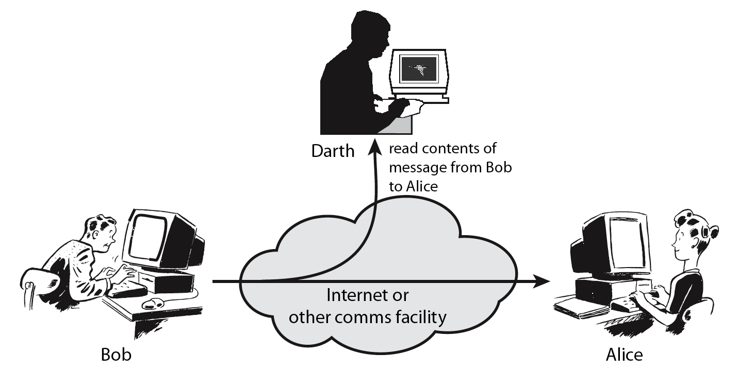
Passive Attack – Interception (Sniffing)
Packet sniffing describes the process of capturing live data as they flow across a network

Slide 30
Passive Attack – Traffic Analysis (Sniffing)
Observe traffic pattern

Slide 31
Active Attack – Interruption (Spoofing)
Packet spoofing occurs when critical information in the packet is forged by an attacker
Block delivery of message

Slide 32
Active Attack – Fabrication (Spoofing)
E.g., TCP session hijacking, DNS cache poisoning
Fabricate message

Slide 33
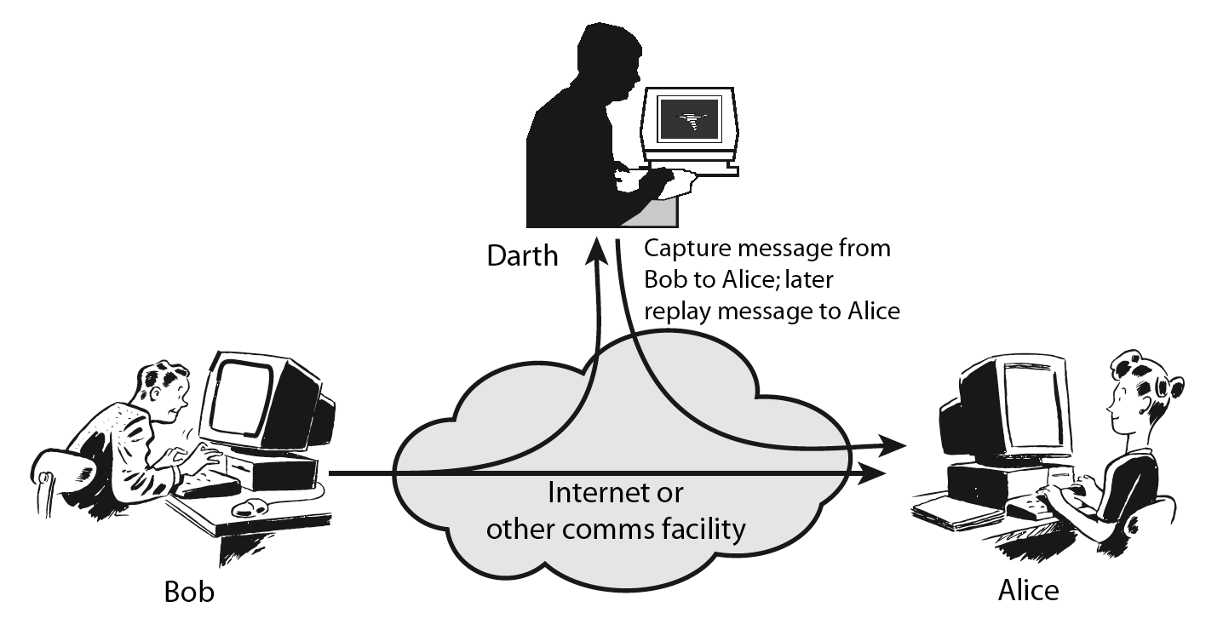
Active Attack – Replay (Sniffing + Spoofing)

Slide 34
Active Attack – Modification (Sniffing + Spoofing)
Modify message

Slide 35
TCP/IP Communication (Recall)

Slide 36
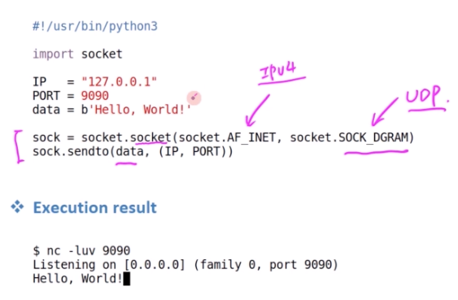
Socket Programming – Sending packets
TCP – connection-oriented transport protocol (error-free)
UDP – connectionless transport protocol (for time-sensitive communication)
Port Number – Route information to particular application process (some numbers are reserved e.g., port 80 for web servers)
UDP Client Example – sending packets using Python; and use Netcat program to test the server

Slide 37
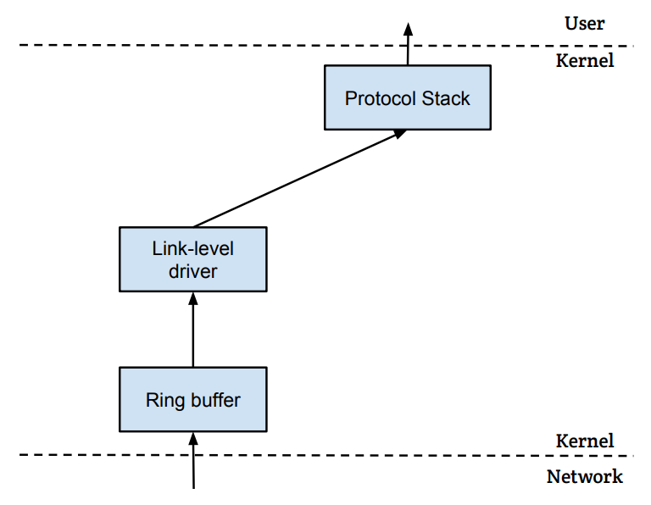
How packets are received?
NIC (Network Interface Card) is a physical or logical link between a machine and a network
Each NIC has a MAC address
Every NIC on the network will hear all the frames on the wire
NIC checks the destination address for every packet, if the address matches the card’s MAC address, it is further copied into a buffer in the kernel
Application
Upper layer processing starting with IP
Socket System Calls
OS control starts
NIC
LAN (Layer 2)

Slide 38
Attack Surfaces
Consist of the reachable and exploitable vulnerabilities in a system
Examples:
Open ports on outward facing Web and other servers, and code listening on those ports
Services available on the inside of a firewall
Code that processes incoming data, email, XML, office documents, and industry-specific custom data exchange formats
Interfaces, SQL, and Web forms
An employee with access to sensitive information vulnerable to a social engineering attack

Slide 39
Attack Surface Categories
Network Attack Surface
Vulnerabilities over an enterprise network, wide-area network, or the Internet
Network protocol vulnerabilities, such as those used for a DoS attack, disruption of communications links
Software Attack Surface
Vulnerabilities in application, utility, or operating system code
Particular focus is Web server software
Human Attack Surface
Vulnerabilities created by personnel or outsiders, such as social engineering, human error, and trusted insiders

Slide 40
Attack Surface Analysis
An attack surface analysis is a useful technique for assessing the scale and severity of threats to a system
A systematic analysis of points of vulnerability makes developers and security analysts aware of where security mechanisms are required
Use Decomposition to document components, applications and their infrastructure → develop data flow diagrams along with privilege boundaries → ensure proper controls are in place for any data crossing boundaries
Once an attack surface is defined, designers may be able to find ways to make the surface smaller, thus making the task of the adversary more difficult
Ignore “high-risk, low-reward” cases
The attack surface also provides guidance on setting priorities for testing, strengthening security measures, or modifying the service or application
Determine the layers of security you need based on the threat, don’t forget they impact performance

Slide 41
Threat Modeling
Threat model - a framework which details internal and external vulnerabilities, as well as objectives and countermeasures
Five major threat modeling steps:
Defining security requirements
Creating an application diagram
Identifying threats
Mitigating threats
Validating that threats have been mitigated

Slide 42
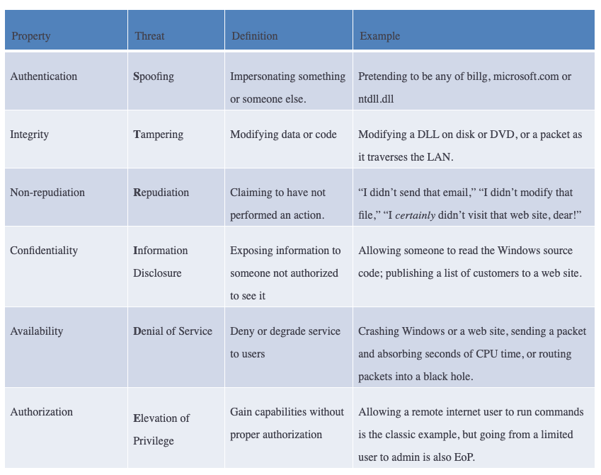
Threat Models
Microsoft STRIDE
https://www.microsoft.com/en-us/securityengineering/sdl/threatmodeling

Slide 43
Fundamental Security Design Principles
Economy of mechanism
Fail-safe defaults
Complete mediation
Open design
Separation of privilege
Least privilege
Least common mechanism
Psychological acceptability
Isolation
Encapsulation
Modularity
Layering
Least astonishment
Despite years of research and development, it has not been possible to develop security design and implementation techniques that systematically exclude security flaws and prevent all unauthorized actions
In the absence of such foolproof techniques, it is useful to have a set of widely agreed design principles that can guide the development of protection mechanisms [NSA/DHS Proposed]

Slide 44
Security Design Principles
Economy of mechanism
Design of security measures embodied in both hardware and software should be as simple and small as possible
The motivation for this principle is that - small design is easier to test and verify thoroughly; complexity complicates management
Fail-safe defaults
Access decisions should be based on permission rather than exclusion
Default situation is lack of access, and the protection scheme identifies conditions under which access is permitted
Complete mediation
Every access must be checked against the access control mechanism
Systems should not rely on access decisions retrieved from a cache
Open design
Design of a security mechanism should be open rather than secret
For example, although encryption keys must be secret, encryption algorithms should be open to public scrutiny

Slide 45
Security Design Principles (2)
Separation of privilege
A practice in which multiple privilege attributes are required to achieve access to a restricted resource
E.g., multifactor user authentication, which requires a password and a smart device, to authorize a user
Least privilege
Every process and every user of the system should operate using the least set of privileges necessary to perform the task
E.g., use of this principle can be seen in role-based access control
Least common mechanism
Design should minimize the functions shared by different users, providing mutual security
This principle helps reduce the number of unintended communication paths
Psychological acceptability
Security mechanisms should not interfere unduly with the work of users, while at the same time meeting the needs of those who authorize access
If security mechanisms hinder the usability or accessibility of resources, users may opt to turn off those mechanisms

Slide 46
Security Design Principles (3)
Isolation
Public access systems should be isolated from critical resources (data, processes, etc.) to prevent disclosure or tampering
In cases where the sensitivity or criticality of the information is high, limit the number of systems on which that data are stored
Encapsulation
A specific form of isolation based on object-oriented functionality
Protection by encapsulating a collection of procedures and data objects so that they may be called only at designated domain entry points
Modularity
Development of security functions as separate, protected modules and use of a modular architecture for mechanism design and practice
Layering
Use of multiple, overlapping protection approaches addressing the people, technology, and operational aspects of information systems
Least astonishment
A program or user interface should always respond in the way that is least likely to astonish the user
For example, the mechanism for authorization should be transparent enough to a user that the user has a good intuitive understanding of the security goals

Slide 47
Network and application layers – security concepts
Packet sniffing and spoofing
Intrusion detection systems
Legal and ethical issues
Module 1

Slide 48
Classes of Intruders – Cyber Criminals
Hackers/Crackers: Individuals or members of an organized crime group with a goal of financial reward
Verizon found that 92% of the breaches they investigated were by outsiders, with 14% by insiders, and with some breaches involving both outsiders and insiders
Insiders were responsible for a small number of very large dataset compromises
Their activities may include:
Identity theft
Theft of financial credentials
Corporate espionage
Data theft
Data ransoming
Typically they are young, often Eastern European, Russian, or southeast Asian hackers, who do business on the Web
They meet in underground forums (e.g., DarkMarket.org and theftservices.com) to trade tips and data and coordinate attacks

Slide 49


Classes of Intruders – Activists
Are either individuals, usually working as insiders, or members of a larger group of outsider attackers, who are motivated by social or political causes
Aim of their attacks is often to promote and publicize their cause typically through:
Website defacement
Denial of service attacks
Theft and distribution of data that results in negative publicity or compromise of their targets (e.g., Edward Snowden, Chelsea Manning)
Also know as Hacktivists - Skill level is often quite low sometimes (i.e., script-kiddies) but there are large skilled groups
(e.g., Anonymous Group, LulzSec)

Slide 50
Examples of Intrusion
NIST SP 800-61 (Computer Security Incident Handling Guide) List:
Remote root compromise
Web server defacement
Guessing/cracking passwords
Copying databases containing credit card numbers
Viewing sensitive data without authorization
Running a packet sniffer
Distributing pirated software
Using an unsecured device to access internal network
Impersonating an executive to get information
Using an unattended workstation
…

Slide 51
Intruder Behavior
Target acquisition and information gathering
Initial access
Privilege escalation
Information gathering or system exploit
Maintaining access
Covering tracks
The techniques and behavior patterns of intruders are constantly shifting, to exploit newly discovered weaknesses and to evade detection and countermeasures
E.g., they start with a phishing attack that results in the installation of malware that steals login credentials that eventually results in the compromise of a Point-of-Sale terminal

Slide 52
Definitions
Security Intrusion:
Unauthorized act of bypassing the security mechanisms of a system
Intrusion Detection:
A hardware or software function that gathers and analyzes information from various areas within a computer or a network to identify possible security intrusions
Intrusion Detection Systems (IDSs) / Intrusion Prevention Systems (IPSs):
Designed to aid countering intrusion threats and are reasonably effective against known, less sophisticated attacks (e.g., large-scale email scams)
They may not be effective against the more sophisticated, targeted attacks by some criminal or state-sponsored intruders (e.g., new, zero-day exploits)
They are part of a defense-in-depth strategy that may also include encryption of sensitive information, detailed audit trails, strong authentication and authorization controls, and active management of application and network security

Slide 53
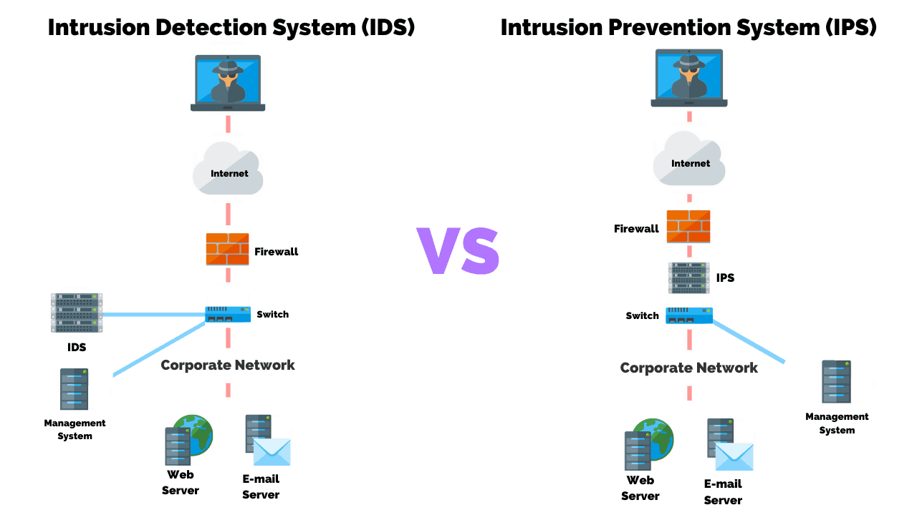
IDS vs IPS

Slide 54
Intrusion Detection System
Host-based IDS (HIDS)
Monitors the characteristics of a single host and its users for suspicious activity
Network-based IDS (NIDS)
Monitors network traffic and analyzes network, transport, and application protocols to identify suspicious activity
Distributed or hybrid IDS
Combines information from a number of sensors, often both host and network based, in a central analyzer and user interface that is able to better identify and respond to intrusion activity
Comprises three logical components:
Sensors – collect data (e.g., network packets, log files, and system call traces)
Analyzers – read sensor data and determine if intrusion has occurred, archive evidence for future analysis, and guide actions
User interface – view output or control system behavior

Slide 55
Analysis Approaches
Signature/Heuristic detection
Anomaly detection
Minimum human supervision
Recover from crashes and reinitializations
Self-monitor and detect intruder modification
Involves the collection of data relating to the behavior of legitimate users over a period of time
Current observed behavior is analyzed to determine whether this behavior is that of a legitimate user or that of an intruder
Can detect unknown, zero-day attacks, as it starts with known good behavior and identifies anomalies to it – but false alarms are common!
Uses a set of known malicious data patterns or attack rules that are compared with current behavior
Also known as misuse detection
Can only identify known attacks for which it has patterns or rules

Slide 56
Anomaly Detection Classification Approaches
Statistical
Analysis of the observed behavior using univariate, multivariate, or time-series models of observed metrics
Knowledge based
Approaches use an expert system that classifies observed behavior according to a set of rules that model legitimate behavior
Machine-learning
Approaches automatically determine a suitable classification model from the training data using data mining techniques
Change-detection principles are used
Difficulty and time consuming to develop a high-quality knowledge from the data, and requires human experts to assist with the process
Training process typically requires lots of sanitized data, and takes significant time and computational resources
Minimum human supervision
Recover from crashes and reinitializations
Self-monitor and detect intruder modification
Two key issues that affect the relative performance of these alternatives are: (i) the efficiency/effectiveness, and (ii) cost of the detection process

Slide 57
Machine Learning Approaches Proposed for an IDS
Bayesian networks: Encode probabilistic relationships among observed metrics
Markov models: Develop a model with sets of states, some possibly hidden, interconnected by transition probabilities
Neural networks: Simulate human brain operation with neurons and synapse between them, that classify observed data
Fuzzy logic: Uses fuzzy set theory where reasoning is approximate, and can accommodate uncertainty
Genetic algorithms: Uses techniques inspired by evolutionary biology, including inheritance, mutation, selection and recombination, to develop classification rules
Clustering and outlier detection: Group the observed data into clusters based on some similarity or distance measure, and then identify subsequent data as either belonging to a cluster or as an outlier
Minimum human supervision
Recover from crashes and reinitializations
Self-monitor and detect intruder modification

Slide 58
Network and application layers – security concepts
Packet sniffing and spoofing
Intrusion detection systems
Legal and ethical issues
Module 1

Slide 59
Privacy
Privacy: Assures that individuals control or influence what information related to them may be collected and stored and by whom and to whom that information may be disclosed
Minimum human supervision
Overlaps with computer security
Dramatic increase in scale of information collected and stored
Data-intensive research, Modeling & Simulation, IoT, Social Networks
Motivated by law enforcement, national security, economic incentives
Individuals have become increasingly aware of access and use of personal information and private details about their lives
Concerns about extent of privacy compromise have led to a variety of legal and technical approaches to reinforcing privacy rights

Slide 60
Privacy Protection
Both policy and technical approaches are needed to protect privacy
In terms of technical approaches, the requirements for privacy protection for data stored on information systems can be addresses in part using the technical mechanisms developed for database security
With regard to social media sites, technical controls include:
The provision of suitable privacy settings to manage who can view data on individuals
Notification when one individual is referenced or tagged in another’s content
Although social media sites include some form of these controls, they are constantly changing, causing frustration for users who are trying to keep up with these mechanisms
Another approach for managing privacy concerns in big data analysis is to anonymize the data, removing any personally identifying information before release to researchers or other organizations for analysis
Minimum human supervision

Slide 61
Data Privacy
In terms of policy, guidelines are needed to manage the use and reuse of big data, ensuring suitable constraints are imposed in order to preserve privacy:
Consent
Ensuring participants can make informed decisions about their participation in the research
Privacy and confidentiality
Privacy is the control that individuals have over who can access their personal information
Confidentiality is the principle that only authorized persons should have access to information
Ownership and authorship
Addresses who has responsibility for the data, and at what point does an individual give up their right to control their personal data
Data sharing – assessing the social benefits of research
The social benefits that result from data matching and reuse of data from one source or research project in another
Governance and custodianship
Oversight and implementation of the management, organization, access, and preservation of digital data
Minimum human supervision

Slide 62
TCP fundamental
Attacks on the TCP protocol
Denial-of-Service attack
SQL injection attack
Cross-side scripting attack
Miscellaneous: Heartbleed bug and attack, Ransomware, Cryptojacking
Module 2

Slide 63
TCP fundamental
Attacks on the TCP protocol
Denial-of-Service attack
SQL injection attack
Cross-side scripting attack
Miscellaneous: Heartbleed bug and attack, Ransomware, Cryptojacking
Module 2

Slide 64
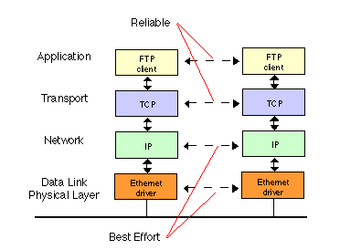
TCP Protocol
Transmission Control Protocol (TCP) is a core protocol of the Internet protocol suite
Sits on the top of the IP layer; transport layer
Provide host-to-host communication services for applications
Two transport Layer protocols
TCP: provides a reliable and ordered communication channel between applications
UDP: lightweight protocol with lower overhead and can be used for applications that do not require reliability or communication order
64

Slide 65
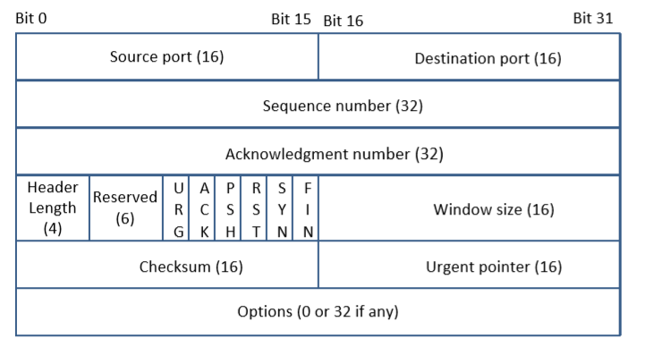
TCP Header
TCP Segment: TCP Header + Data.
Source and Destination port (16 bits each): Specify port numbers of the sender and the receiver.
Sequence number (32 bits) : Specifies the sequence number of the first octet in the TCP segment. If SYN bit is set, it is the initial sequence number.
Acknowledgement number (32 bits): Contains the value of the next sequence number expected by the sender of this segment. Valid only if ACK bit is set.
65
Notes:
TCP Sequence number # to maintain order of packets; flow/congestion control
Even if no data to send, I have to send ACK otherwise a resend will be required
TCP is bidirectional – sequence number will be different in both directions – acknowledgement is for received sequence number
6 standard bits; ACK – if turn ON/OFF it determines acknowledgement
If no options, header size is fixed
Urgent pointer – if data is urgent and do not want to put in end of header - turn ON urgent pointer that points to urgent data in packet

Slide 66
TCP Header
Header length (4 bits): Length of TCP header is measured by the number of 32-bit words in the header, so we multiply by 4 to get number of octets in the header.
Reserved (6 bits): This field is not used.
Code bits (6 bits): There are six code bits, including SYN,FIN,ACK,RST,PSH and URG.
Window (16 bits): Window advertisement to specify the number of octets that the sender of this TCP segment is willing to accept. The purpose of this field is for flow control.
Checksum (16 bits): The checksum is calculated using part of IP header, TCP header and TCP data.
Urgent Pointer (16 bits): If the URG code bit is set, the first part of the data contains urgent data (do not consume sequence numbers). The urgent pointer specifies where the urgent data ends and the normal TCP data starts. Urgent data is for priority purposes as they do not wait in line in the receive buffer, and will be delivered to the applications immediately.
Options (0-320 bits, divisible by 32): TCP segments can carry a variable length of options which provide a way to deal with the limitations of the original header.
66
Notes:
Flow Control : If one end of the connection sends data too fast, it may overwhelm the receive buffer of the other end and cause data being dropped.
By putting a smaller window value, the receiver can tell the sender to slow down.

Slide 67
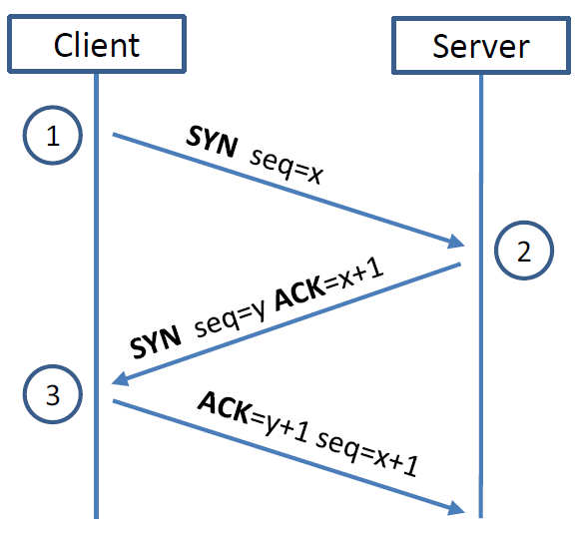
TCP 3-way Handshake Protocol
SYN Packet:
The client sends a special packet called SYN packet to the server using a randomly generated number x as its sequence number
SYN-ACK Packet:
On receiving it, the server sends a reply packet using its own randomly generated number y as its sequence number
ACK Packet
Client sends out ACK packet to conclude the handshake
Kernel establishes send and receive buffer on both sides
67
Notes:
Kernel establishes send and receive buffer on both sides

Slide 68
TCP 3-way Handshake Protocol
When the server receives the initial SYN packet, it uses TCB (Transmission Control Block) to store the information about the connection
This is called half-open connection as only client-server connection is confirmed
The server stores the TCB in a queue that is only for the half-open connection
After the server gets ACK packet, it will take this TCB out of the queue and store in a different place
If ACK doesn’t arrive, the server will resend SYN+ACK packet; The TCB will eventually be discarded after a certain time period
68
Notes:
The queue is not large, there is a limit – that creates issues
DoS attack – brute force attack won’t work for powerful server – they find Achilles heel to attack i.e., exhaust the queue with many SYN flooding packets so that there is no space for half-open connection

Slide 69
TCP 3-way Handshake Protocol
SYN Packet:
The client sends a special packet called SYN packet to the server using a randomly generated number x as its sequence number
SYN-ACK Packet:
On receiving it, the server sends a reply packet using its own randomly generated number y as its sequence number
ACK Packet
Client sends out ACK packet to conclude the handshake
Kernel establishes send and receive buffer on both sides
69
Notes:
Kernel establishes send and receive buffer on both sides

Slide 70
TCP 3-way Handshake Protocol
When the server receives the initial SYN packet, it uses TCB (Transmission Control Block) to store the information about the connection
This is called half-open connection as only client-server connection is confirmed
The server stores the TCB in a queue that is only for the half-open connection
After the server gets ACK packet, it will take this TCB out of the queue and store in a different place
If ACK doesn’t arrive, the server will resend SYN+ACK packet; The TCB will eventually be discarded after a certain time period
70
Notes:
The queue is not large, there is a limit – that creates issues
DoS attack – brute force attack won’t work for powerful server – they find Achilles heel to attack i.e., exhaust the queue with many SYN flooding packets so that there is no space for half-open connection

Slide 71
TCP fundamental
Attacks on the TCP protocol
Denial-of-Service attack
SQL injection attack
Cross-side scripting attack
Miscellaneous: Heartbleed bug and attack, Ransomware, Cryptojacking
Module 2

Slide 72
Attack on connect – TCP SYN Flooding
Attack to terminate - TCP Reset Attack
Understanding Cookies
Attack during session – TCP Hijacking Attack
Module 2
Attacks on the TCP protocol

Slide 73
Attack on connect – TCP SYN Flooding
Attack to terminate - TCP Reset Attack
Understanding Cookies
Attack during session – TCP Hijacking Attack
Module 2
Attacks on the TCP protocol

Slide 74
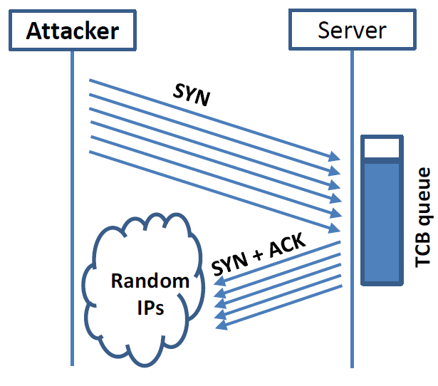
SYN Flooding Attack
Idea : To fill the queue storing the half-open connections so that there will be no space to store TCB for any new half-open connection, basically the server cannot accept any new SYN packets.
Steps to achieve this : Continuously send a lot of SYN packets to the server. This consumes the space in the queue by inserting the TCB record
Do not finish the 3rd step of handshake as it will dequeue the TCB record
When flooding the server with SYN packets, attackers use random source IP addresses; otherwise the attacks may be blocked by the firewalls…
74

Slide 75
Countermeasures: SYN Cookies
After a server receives a SYN packet, it calculates a keyed hash (H) from the information in the packet using a secret key that is only known to the server
This hash (H) is sent to the client as the initial sequence number from the server. H is called SYN cookie
The server will not store the half-open connection in its queue when SYN Cookie kicks-in after a certain number of SYN packets are received; instead information is put in the packet to see if it is a real connection to get information back
If the client is an attacker, H will not reach the attacker
If the client is not an attacker, it sends H+1 in the acknowledgement field
The server checks if the number in the acknowledgement field is valid or not by recalculating the cookie
75

Slide 76
Attack on connect – TCP SYN Flooding
Attack to terminate - TCP Reset Attack
Understanding Cookies
Attack during session – TCP Hijacking Attack
Module 2
Attacks on the TCP protocol

Slide 77
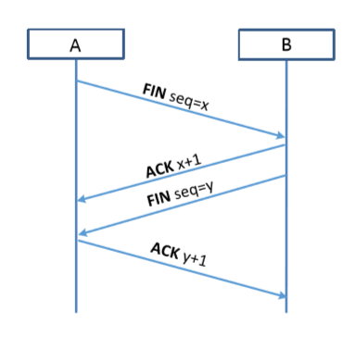
TCP Reset Attack
To disconnect a TCP connection gracefully :
A sends out a “FIN” packet to B
B replies with an “ACK” packet. This closes the A-to-B communication
Now, B sends a “FIN” packet to A and A replies with “ACK”
Using Reset flag (another way to terminate connection between A & B in abnormal/urgent situations) :
One of the parties sends RST packet to immediately break the connection
77

Slide 78
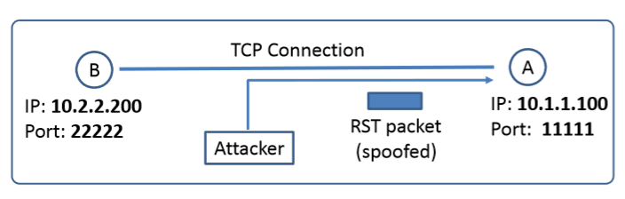
TCP Reset Attack
Goal: To break up a TCP connection between A and B
Spoofed RST Packet: The following fields need to be set correctly:
Source IP address, Source Port, Destination IP address, Destination Port (i.e., 4-Tuple to identify a TCP connection)
Sequence number (within the receiver’s window)
Fun fact: This tampering technique can be used by a firewall or abused by a malicious attacker to interrupt Internet connections.
The Great Firewall of China, and Iranian Internet censors are known to use TCP reset attacks to interfere with and block connections as a major method to carry out Internet censorship.
78

Slide 79
Attack on connect – TCP SYN Flooding
Attack to terminate - TCP Reset Attack
Understanding Cookies
Attack during session – TCP Hijacking Attack
Module 2
Attacks on the TCP protocol

Slide 80
Attack on connect – TCP SYN Flooding
Attack to terminate - TCP Reset Attack
Understanding Cookies
Attack during session – TCP Hijacking Attack
Module 2
Attacks on the TCP protocol

Slide 81
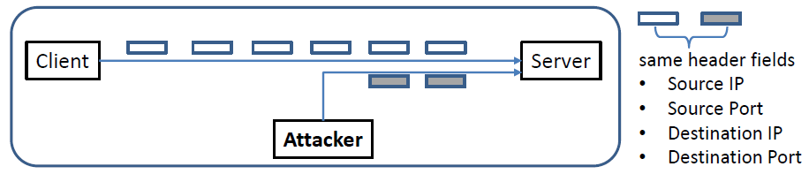
TCP Session Hijacking Attack
Goal: To inject data in an established connection.
(This is different from the DoS attack in TCP SYN Flooding or Reset)
Spoofed TCP Packet: The following fields need to be set correctly:
Source IP address, Source Port,
Destination IP address, Destination Port
Sequence number (within the receiver’s window)
81

Slide 82
Defending Against Session Hijacking
Making it difficult for attackers to spoof packets
Randomize source port number
Randomize initial sequence number
Note: Randomization is NOT effective against local attacks that can sniff packets and determine this information
Encrypting payload
82

Slide 83
TCP fundamental
Attacks on the TCP protocol
Denial-of-Service attack
SQL injection attack
Cross-side scripting attack
Miscellaneous: Heartbleed bug and attack, Ransomware, Cryptojacking
Module 2

Slide 84
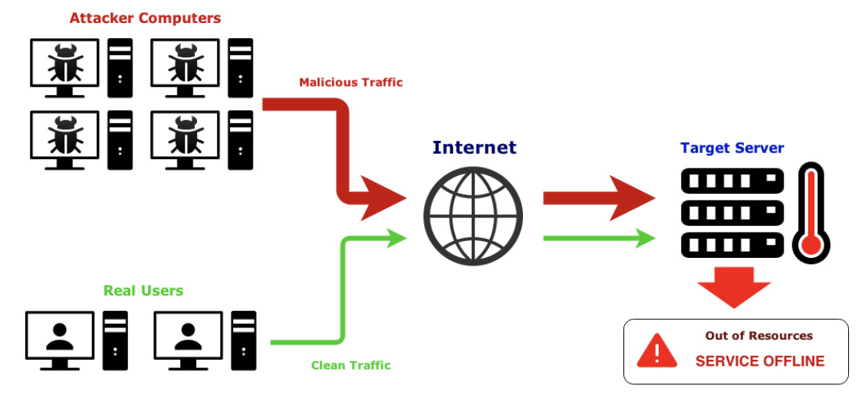
Denial-of-Service (DoS) Attack
A denial of service (DoS) is an action that prevents or impairs the authorized use of networks, systems, or applications by exhausting resources such as central processing units (CPU), memory, bandwidth, and disk space
A form of attack on the availability of a service; focus is generally on network services that are attacked over their network connection
84

Slide 85
DoS Attack - Facts
One of the most common types of attacks
Aims to prevent users from accessing system
Requires a minimum of technical skill
Effective because computers and other systems have physical limitations
Number of simultaneous users
Size of files
Speed of data transmission
Amount of data stored

Slide 86
Denial-of-Service (DoS) Attack Categories
Network bandwidth
Relates to the capacity of the network links connecting a server to the Internet
For most organizations this is their connection to their Internet Service Provider (ISP)
System resources
Aims to overload or trigger a bug to crash the network handling software using ‘poison packets’
Application resources
‘Cyberslam’ involving a number of valid requests (e.g., db query), each of which consumes significant resources, thus limiting the ability of the server to respond to requests from legitimate users
86
Notes:
From this definition, you can see that there are several categories of resources
that could be attacked:
• Network bandwidth
• System resources
• Application resources
Network bandwidth relates to the capacity of the network links connecting a server
to the wider Internet. For most organizations, this is their connection to their Internet
service provider (ISP), as shown in the example network in Figure 7.1. Usually this
connection will have a lower capacity than the links within and between ISP routers.
This means it is possible for more traffic to arrive at the ISP’s routers over these
higher-capacity links than can be carried over the link to the organization. In this
circumstance, the router must discard some packets, delivering only as many as can
be handled by the link. In normal network operation such high loads might occur
to a popular server experiencing traffic from a large number of legitimate users. A
random portion of these users will experience a degraded or nonexistent service as
a consequence. This is expected behavior for an overloaded TCP/IP network link.
In a DoS attack, the vast majority of traffic directed at the target server is malicious,
generated either directly or indirectly by the attacker. This traffic overwhelms
any legitimate traffic, effectively denying legitimate users access to the server. Some
recent high volume attacks have even been directed at the ISP network supporting
the target organization, aiming to disrupt its connections to other networks. A number
of recent DDoS attacks are listed in [AROR11], with comments on their growth
in volume and impact.
A DoS attack targeting system resources typically aims to overload or crash its
network handling software. Rather than consuming bandwidth with large volumes
of traffic, specific types of packets are sent that consume the limited resources available
on the system. These include temporary buffers used to hold arriving packets,
tables of open connections, and similar memory data structures. The SYN spoofing
attack, which we discuss next, is of this type. It targets the table of TCP connections
on the server.
Another form of system resource attack uses packets whose structure triggers
a bug in the system’s network handling software, causing it to crash. This means the
system can no longer communicate over the network until this software is reloaded,
generally by rebooting the target system. This is known as a poison packet . The
classic ping of death and teardrop attacks, directed at older Windows 9x systems,
were of this form. These targeted bugs in the Windows network code that handled
ICMP (Internet Control Message Protocol) echo request packets and packet fragmentation,
respectively.
An attack on a specific application, such as a Web server, typically involves a
number of valid requests, each of which consumes significant resources. This then
limits the ability of the server to respond to requests from other users. For example,
a Web server might include the ability to make database queries. If a large,
costly query can be constructed, then an attacker could generate a large number of
these that severely load the server. This limits its ability to respond to valid requests
from other users. This type of attack is known as a cyberslam . [KAND05] discusses
attacks of this kind, and suggests some possible countermeasures. Another
alternative is to construct a request that triggers a bug in the server program, causing
it to crash. This means the server is no longer able to respond to requests until
it is restarted.
DoS attacks may also be characterized by how many systems are used to direct
traffic at the target system. Originally only one, or a small number of source systems
directly under the attacker’s control, was used. This is all that is required to send the
packets needed for any attack targeting a bug in a server’s network handling code or
some application. Attacks requiring high traffic volumes are more commonly sent
from multiple systems at the same time, using distributed or amplified forms of DoS
attacks. We discuss these later in this chapter.

Slide 87
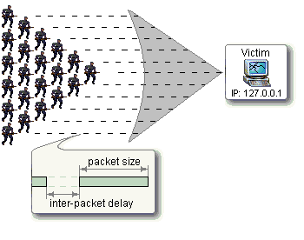
Classic DoS Attacks
Flooding ping command
Aim of this attack is to overwhelm the capacity of the network connection to the target organization
Traffic can be handled by higher capacity links on the path, but packets are discarded as capacity decreases
Source of the attack is clearly identified (e.g., in ICMP echo request) unless a spoofed address is used - attacker might use a large company’s Web server to target a medium-sized company with a lower-capacity network connection
Network performance is noticeably affected
Defense: Load balancers, firewalls
87
Notes:
The simplest classical DoS attack is a flooding attack on an organization. The aim
of this attack is to overwhelm the capacity of the network connection to the target
organization. If the attacker has access to a system with a higher-capacity network
connection, then this system can likely generate a higher volume of traffic than the
lower-capacity target connection can handle. For example, in the network shown
in Figure 7.1 , the attacker might use the large company’s Web server to target the
medium-sized company with a lower-capacity network connection. The attack might
be as simple as using a flooding ping command directed at the Web server in the
target company. This traffic can be handled by the higher-capacity links on the path
between them, until the final router in the Internet cloud is reached. At this point
some packets must be discarded, with the remainder consuming most of the capacity
on the link to the medium-sized company. Other valid traffic will have little chance
of surviving discard as the router responds to the resulting congestion on this link.
In this classic ping flood attack, the source of the attack is clearly identified
since its address is used as the source address in the ICMP echo request packets. This
has two disadvantages from the attacker’s perspective. First, the source of the attack
is explicitly identified, increasing the chance that the attacker can be identified and
legal action taken in response. Second, the targeted system will attempt to respond to
the packets being sent. In the case of any ICMP echo request packets received by the
server, it would respond to each with an ICMP echo response packet directed back
to the sender. This effectively reflects the attack back at the source system. Since
the source system has a higher network bandwidth, it is more likely to survive this
reflected attack. However, its network performance will be noticeably affected, again
increasing the chances of the attack being detected and action taken in response. For
both of these reasons the attacker would like to hide the identity of the source system.
This means that any such attack packets need to use a falsified, or spoofed, address.

Slide 88
Flooding Attacks
Classified based on network protocol used
Intent is to overload the network capacity on some link to a server
Virtually any type of network packet can be used
ICMP flood
Ping flood using ICMP echo request packets
Traditionally network administrators allow such packets into their networks because ping is a useful network diagnostic tool
UDP flood
Uses UDP packets directed to some port number on the target system
TCP SYN flood
Sends TCP packets to the target system
High volume of packets to attack the network handling code in the operating system; denies legitimate user access
88
Notes:
Flooding attacks take a variety of forms, based on which network protocol is being
used to implement the attack. In all cases the intent is generally to overload the
network capacity on some link to a server. The attack may alternatively aim to
overload the server’s ability to handle and respond to this traffic. These attacks flood
the network link to the server with a torrent of malicious packets competing with, and
usually overwhelming, valid traffic flowing to the server. In response to the congestion
this causes in some routers on the path to the targeted server, many packets will be
dropped. Valid traffic has a low probability of surviving discard caused by this flood
and hence of accessing the server. This results in the server’s ability to respond to
network connection requests being either severely degraded or failing entirely.
Virtually any type of network packet can be used in a flooding attack. It simply
needs to be of a type that is permitted to flow over the links toward the targeted system,
so that it can consume all available capacity on some link to the target server. Indeed,
the larger the packet, the more effective is the attack. Common flooding attacks use
any of the ICMP, UDP, or TCP SYN packet types. It is even possible to flood with
some other IP packet type. However, as these are less common and their usage more
targeted, it is easier to filter for them and hence hinder or block such attacks.
The ping flood using ICMP echo request packets we discuss in Section 7.1 is a classic
example of an ICMP flooding attack. This type of ICMP packet was chosen since
traditionally network administrators allowed such packets into their networks, as
ping is a useful network diagnostic tool. More recently, many organizations have
restricted the ability of these packets to pass through their firewalls. In response,
attackers have started using other ICMP packet types. Since some of these should
be handled to allow the correct operation of TCP/IP, they are much more likely to
be allowed through an organization’s firewall. Filtering some of these critical ICMP
packet types would degrade or break normal TCP/IP network behavior. ICMP
destination unreachable and time exceeded packets are examples of such critical
packet types.
An attacker can generate large volumes of one of these packet types. Because
these packets include part of some notional erroneous packet that supposedly caused
the error being reported, they can be made comparatively large, increasing their effectiveness
in flooding the link. ICMP flood attacks remain one of the most common
types of DDoS attacks [SYMA16].
An alternative to using ICMP packets is to use UDP packets directed to some port
number, and hence potential service, on the target system. A common choice was a
packet directed at the diagnostic echo service, commonly enabled on many server
systems by default. If the server had this service running, it would respond with a
UDP packet back to the claimed source containing the original packet data contents.
If the service is not running, then the packet is discarded, and possibly an
ICMP destination unreachable packet is returned to the sender. By then the attack
has already achieved its goal of occupying capacity on the link to the server. Just
about any UDP port number can be used for this end. Any packets generated in
response only serve to increase the load on the server and its network links.
Spoofed source addresses are normally used if the attack is generated using
a single source system, for the same reasons as with ICMP attacks. If multiple systems
are used for the attack, often the real addresses of the compromised, zombie,
systems are used. When multiple systems are used, the consequences of both the
reflected flow of packets and the ability to identify the attacker are reduced.
Another alternative is to send TCP packets to the target system. Most likely these
would be normal TCP connection requests, with either real or spoofed source
addresses. They would have an effect similar to the SYN spoofing attack we’ve
described. In this case, though, it is the total volume of packets that is the aim of the
attack rather than the system code. This is the difference between a SYN spoofing
attack and a SYN flooding attack.
This attack could also use TCP data packets, which would be rejected by the
server as not belonging to any known connection. But again, by this time the attack
has already succeeded in flooding the links to the server.
All of these flooding attack variants are limited in the total volume of traffic
that can be generated if just a single system is used to launch the attack. The use
of a single system also means the attacker is easier to trace. For these reasons, a
variety of more sophisticated attacks, involving multiple attacking systems, have
been developed. By using multiple systems, the attacker can significantly scale up
the volume of traffic that can be generated. Each of these systems need not be particularly
powerful or on a high-capacity link. But what they don’t have individually,
they more than compensate for in large numbers. Also, by directing the attack
through intermediaries, the attacker is further distanced from the target and significantly
harder to locate and identify. Indirect attack types that utilize multiple
systems include
• Distributed denial-of-service attacks
• Reflector attacks
• Amplifier attacks
We consider each of these in turn.

Slide 89
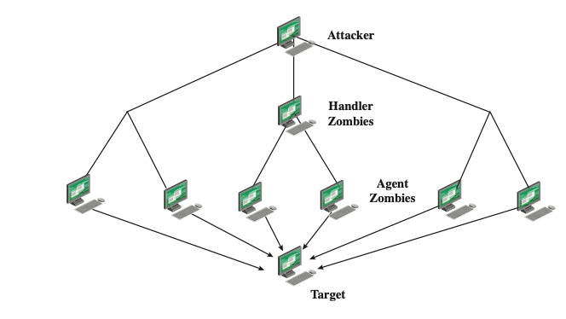
Distributed DoS (DDoS) Attacks
Use of multiple systems to generate flooding attacks
Attacker uses a flaw in operating system or in a common application to gain access and installs their zombie program on it
Large collections of such systems under the control of one attacker’s control can be created, forming a botnet
89
Notes:
Recognizing the limitations of flooding attacks generated by a single system, one
of the earlier significant developments in DoS attack tools was the use of multiple
systems to generate attacks. These systems were typically compromised user workstations
or PCs. The attacker uses malware to subvert the system and to install an attack
agent, which they can control. Such systems are known as zombies. Large collections
of such systems under the control of one attacker can be created, collectively forming
a botnet , as we discussed in Chapter 6. Such networks of compromised systems
are a favorite tool of attackers, and can be used for a variety of purposes, including
distributed denial-of-service (DDoS) attacks. Indeed, there is an underground
economy that creates and hires out botnets for use in such attacks. [SYMA16] report
evidence that 40% of DDoS attacks in 2015 were from such botnets for hire. In the
example network shown in Figure 7.1, some of the broadband user systems may be
compromised and used as zombies to attack any of the company or other links shown.
Many other DDoS tools have been developed since. Instead of using dedicated
handler programs, many now use an IRC or similar instant messaging server
program to manage communications with the agents. Many of these more recent
tools also use cryptographic mechanisms to authenticate the agents to the handlers,
in order to hinder analysis of command traffic.
The best defense against being an unwitting participant in a DDoS attack is to
prevent your systems from being compromised. This requires good system security
practices and keeping the operating systems and applications on such systems current
and patched.
For the target of a DDoS attack, the response is the same as for any flooding
attack, but with greater volume and complexity. We discuss appropriate defenses
and responses in Sections 7.6 and 7.7.

Slide 90
Hypertext Transfer Protocol (HTTP) Based Attacks
HTTP flood attack
Attack that bombards Web servers with HTTP requests
Consumes considerable resources
Spidering - Bots start from a given HTTP link and follow all links on the provided Web site in a recursive way
Slowloris attack
Attempts to monopolize a server’s multi-threading by sending HTTP requests that never complete
Eventually consumes Web server’s connection capacity
Utilizes legitimate HTTP traffic
Existing intrusion detection and prevention solutions that rely on signatures to detect attacks will generally not recognize Slowloris
Rate limiting number of host connections can help defend or delayed binding can be done by a load balancer to ensure web server or proxy will not see incomplete requests
90
Notes:
We consider two different approaches to exploiting the Hypertext Transfer Protocol
(HTTP) to deny service.
An HTTP flood refers to an attack that bombards Web servers
with HTTP requests. Typically, this is a DDoS attack, with HTTP requests coming
from many different bots. The requests can be designed to consume considerable
resources. For example, an HTTP request to download a large file from the target
causes the Web server to read the file from hard disk, store it in memory, convert it
into a packet stream, and then transmit the packets. This process consumes memory,
processing, and transmission resources.
A variant of this attack is known as a recursive HTTP flood. In this case, the
bots start from a given HTTP link and then follows all links on the provided Web
site in a recursive way. This is also called spidering.
An intriguing and unusual form of HTTP-based attack is Slowloris
[SOUR12], [DAMO12]. Slowloris exploits the common server technique of using
multiple threads to support multiple requests to the same server application. It
attempts to monopolize all of the available request handling threads on the Web
server by sending HTTP requests that never complete. Since each request consumes
a thread, the Slowloris attack eventually consumes all of the Web server’s connection
capacity, effectively denying access to legitimate users.
The HTTP protocol specification (RFC2616) states that a blank line must be
used to indicate the end of the request headers and the beginning of the payload,
if any. Once the entire request is received, the Web server may then respond. The
Slowloris attack operates by establishing multiple connections to the Web server.
On each connection, it sends an incomplete request that does not include the terminating
newline sequence. The attacker sends additional header lines periodically to
keep the connection alive, but never sends the terminating newline sequence. The
Web server keeps the connection open, expecting more information to complete
the request. As the attack continues, the volume of long-standing Slowloris connections
increases, eventually consuming all available Web server connections, thus
rendering the Web server unavailable to respond to legitimate requests.
Slowloris is different from typical denials of service in that Slowloris traffic
utilizes legitimate HTTP traffic, and does not rely on using special “bad” HTTP
requests that exploit bugs in specific HTTP servers. Because of this, existing intrusion
detection and intrusion prevention solutions that rely on signatures to detect
attacks will generally not recognize Slowloris. This means that Slowloris is capable
of being effective even when standard enterprise-grade intrusion detection and
intrusion prevention systems are in place.
There are a number of countermeasures that can be taken against Slowloris
type attacks, including limiting the rate of incoming connections from a particular
host; varying the timeout on connections as a function of the number of connections;
and delayed binding. Delayed binding is performed by load balancing software. In
essence, the load balancer performs an HTTP request header completeness check,
which means that the HTTP request will not be sent to the appropriate Web server
until the final two carriage return and line feeds are sent by the HTTP client. This is
the key bit of information. Basically, delayed binding ensures that your Web server
or proxy will never see any of the incomplete requests being sent out by Slowloris.

Slide 91
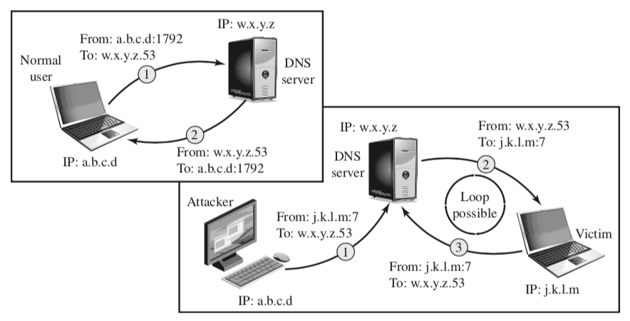
DNS Reflection Attack
Reflector attack establishes a self-contained loop between the intermediary and the target system; Both systems act as reflectors
Most reflector attacks can be prevented through network-based and host-based firewall rulesets that reject suspicious combinations of source and destination ports
The attacker sends a query to the DNS server with a spoofed IP source address of j.k.l.m; this is the IP address of the target. The attacker uses port 7, which is usually associated with echo, a reflector service. The DNS server then sends a response to the victim of the attack, j.k.l.m, addressed to port 7. If the victim is offering the echo service, it may create a packet that echoes the received data back to the DNS server. This can cause a loop between the DNS server and the victim.
Normal DNS Operation
DNS Operation under Attack
The DNS client sends a query from its UDP port 1792 to the server’s DNS port 53 to obtain the IP address of a domain name. The DNS server sends a UDP response packet including the IP address.
91
Notes:
A further variation of the reflector attack establishes a self-contained loop
between the intermediary and the target system. Both systems act as reflectors.
Figure 7.6 shows this type of attack. The upper part of the figure shows normal
Domain Name System operation. The DNS client sends a query from its UDP
port 1792 to the server’s DNS port 53 to obtain the IP address of a domain name.
The DNS server sends a UDP response packet including the IP address. The lower
part of the figure shows a reflection attack using DNS. The attacker sends a query
to the DNS server with a spoofed IP source address of j.k.l.m; this is the IP address
of the target. The attacker uses port 7, which is usually associated with echo, a
reflector service. The DNS server then sends a response to the victim of the attack,
j.k.l.m, addressed to port 7. If the victim is offering the echo service, it may create a
packet that echoes the received data back to the DNS server. This can cause a loop
between the DNS server and the victim if the DNS server responds to the packets
sent by the victim. Most reflector attacks can be prevented through network-based
and host-based firewall rulesets that reject suspicious combinations of source and
destination ports.
While very effective if possible, this type of attack is fairly easy to filter for
because the combinations of service ports used should never occur in normal network
operation.
When implementing any of these reflection attacks, the attacker could use just
one system as the original source of packets. This suffices, particularly if a service
is used that generates larger response packets than those originally sent to the intermediary.
Alternatively, multiple systems might be used to generate higher volumes
of traffic to be reflected and to further obscure the path back to the attacker. Typically a botnet
would be used in this case.
Another characteristic of reflection attacks is the lack of backscatter traffic.
In both direct flooding attacks and SYN spoofing attacks, the use of spoofed
source addresses results in response packets being scattered across the Internet and
thus detectable. This allows security researchers to estimate the volumes of such
attacks. In reflection attacks, the spoofed source address directs all the packets at
the desired target and any responses to the intermediary. There is no generally visible
side effect of these attacks, making them much harder to quantify. Evidence of
them is only available from either the targeted systems and their ISPs or the intermediary
systems. In either case, specific instrumentation and monitoring would be
needed to collect this evidence.
Fundamental to the success of reflection attacks is the ability to create
spoofed-source packets. If filters are in place that block spoofed-source packets, as
described in (RFC 2827), then these attacks are simply not possible. This is the most
basic, fundamental defense against such attacks. This is not the case with either
SYN spoofing or flooding attacks (distributed or not). They can succeed using real
source addresses, with the consequences already noted.

Slide 92
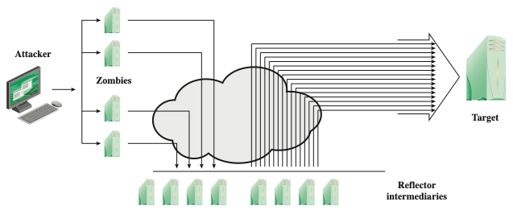
Amplification Attacks
They are a variant of reflector attacks and also involve sending a packet with a spoofed source address for the target system to intermediaries
They differ in generating multiple response packets for each original packet sent; this can be achieved by directing the original request to the broadcast address for some network; as a result, all hosts on that network can potentially respond to the request, generating a flood of responses to a victim (spoofed) IP address
It is only necessary to use a service handled by large numbers of hosts on the intermediate network; the well-known Smurf DoS program used ping flood mechanism using ICMP echo request packets
The best additional defense against this form of attack is to not allow directed broadcasts to be routed into a network from outside
92
Notes:
Amplification attacks are a variant of reflector attacks and also involve sending a
packet with a spoofed source address for the target system to intermediaries. They
differ in generating multiple response packets for each original packet sent. This can
be achieved by directing the original request to the broadcast address for some network.
As a result, all hosts on that network can potentially respond to the request,
generating a flood of responses as shown in Figure 7.7 . It is only necessary to use
a service handled by large numbers of hosts on the intermediate network. A ping
flood using ICMP echo request packets was a common choice, since this service
is a fundamental component of TCP/IP implementations and was often allowed
into networks. The well-known smurf DoS program used this mechanism and was
widely popular for some time. Another possibility is to use a suitable UDP service,
such as the echo service. The fraggle program implemented this variant. Note that
TCP services cannot be used in this type of attack; because they are connection
oriented, they cannot be directed at a broadcast address. Broadcasts are inherently
connectionless.
The best additional defense against this form of attack is to not allow directed
broadcasts to be routed into a network from outside. Indeed, this is another longstanding
security recommendation, unfortunately about as widely implemented as
that for blocking spoofed source addresses. If these forms of filtering are in place,
these attacks cannot succeed. Another defense is to limit network services like echo
and ping from being accessed from outside an organization. This restricts which
services could be used in these attacks, at a cost in ease of analyzing some legitimate
network problems.
Attackers scan the Internet looking for well-connected networks that do allow
directed broadcasts and that implement suitable services attackers can reflect off.
These lists are traded and used to implement such attacks.

Slide 93
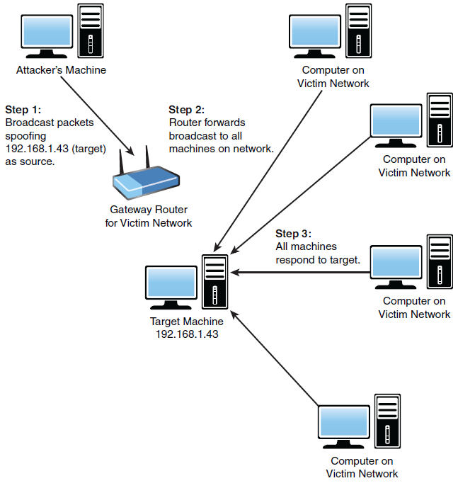
Amplification Attacks cont.
Smurf Attack
93
Notes:
Amplification attacks are a variant of reflector attacks and also involve sending a
packet with a spoofed source address for the target system to intermediaries. They
differ in generating multiple response packets for each original packet sent. This can
be achieved by directing the original request to the broadcast address for some network.
As a result, all hosts on that network can potentially respond to the request,
generating a flood of responses as shown in Figure 7.7 . It is only necessary to use
a service handled by large numbers of hosts on the intermediate network. A ping
flood using ICMP echo request packets was a common choice, since this service
is a fundamental component of TCP/IP implementations and was often allowed
into networks. The well-known smurf DoS program used this mechanism and was
widely popular for some time. Another possibility is to use a suitable UDP service,
such as the echo service. The fraggle program implemented this variant. Note that
TCP services cannot be used in this type of attack; because they are connection
oriented, they cannot be directed at a broadcast address. Broadcasts are inherently
connectionless.
The best additional defense against this form of attack is to not allow directed
broadcasts to be routed into a network from outside. Indeed, this is another longstanding
security recommendation, unfortunately about as widely implemented as
that for blocking spoofed source addresses. If these forms of filtering are in place,
these attacks cannot succeed. Another defense is to limit network services like echo
and ping from being accessed from outside an organization. This restricts which
services could be used in these attacks, at a cost in ease of analyzing some legitimate
network problems.
Attackers scan the Internet looking for well-connected networks that do allow
directed broadcasts and that implement suitable services attackers can reflect off.
These lists are traded and used to implement such attacks.

Slide 94
DNS Amplification Attack
Use packets directed at a legitimate DNS server as the intermediary system
Attacker creates a series of DNS requests containing the spoofed source address of the target system
Exploit DNS behavior to convert a small request to a much larger response (amplification)
Target is flooded with responses
Basic defense against this attack is to prevent the use of spoofed source addresses
94
Notes:
In addition to the DNS reflection attack discussed previously, a further variant of an
amplification attack uses packets directed at a legitimate DNS server as the intermediary
system. Attackers gain attack amplification by exploiting the behavior of the
DNS protocol to convert a small request into a much larger response. This contrasts
with the original amplifier attacks, which use responses from multiple systems to a
single request to gain amplification. Using the classic DNS protocol, a 60-byte UDP
request packet can easily result in a 512-byte UDP response, the maximum traditionally
allowed. All that is needed is a name server with DNS records large enough for
this to occur.
These attacks have been seen for several years. More recently, the DNS
protocol has been extended to allow much larger responses of over 4000 bytes to
support extended DNS features such as IPv6, security, and others. By targeting
servers that support the extended DNS protocol, significantly greater amplification
can be achieved than with the classic DNS protocol.
In this attack, a selection of suitable DNS servers with good network connections
are chosen. The attacker creates a series of DNS requests containing
the spoofed source address of the target system. These are directed at a number
of the selected name servers. The servers respond to these requests, sending the
replies to the spoofed source, which appears to them to be the legitimate requesting
system. The target is then flooded with their responses. Because of the amplification
achieved, the attacker need only generate a moderate flow of packets to
cause a larger, amplified flow to flood and overflow the link to the target system.
Intermediate systems will also experience significant loads. By using a number of
high-capacity, well-connected systems, the attacker can ensure that intermediate
systems are not overloaded, allowing the attack to proceed.
A further variant of this attack exploits recursive DNS name servers. This is
a basic feature of the DNS protocol that permits a DNS name server to query a
number of other servers to resolve a query for its clients. The intention was that this
feature is used to support local clients only. However, many DNS systems support
recursion by default for any requests. They are known as open recursive DNS servers.
Attackers may exploit such servers for a number of DNS-based attacks, including
the DNS amplification DoS attack. In this variant, the attacker targets a number
of open recursive DNS servers. The name information being used for the attack
need not reside on these servers, but can be sourced from anywhere on the Internet.
The results are directed at the desired target using spoofed source addresses.
Like all the reflection-based attacks, the basic defense against these is to
prevent the use of spoofed source addresses. Appropriate configuration of DNS
servers, in particular limiting recursive responses to internal client systems only, as
described in RFC 5358, can restrict some variants of this attack.

Slide 95
Another way to category DDoS
Volume Based Attacks Includes UDP floods, ICMP floods, and other spoofed-packet floods. The attack’s goal is to saturate the bandwidth of the attacked site, and magnitude is measured in bits per second (Bps).
Protocol Attacks Includes SYN floods, fragmented packet attacks, Ping of Death, Smurf DDoS, and more. This type of attack consumes actual server resources, or those of intermediate communication equipment, such as firewalls and load balancers, and is measured in packets per second (Pps).
Application Layer Attacks Includes HTTP Based Attacks, attacks that target Apache, Windows, or OpenBSD vulnerabilities, and more. Comprised of seemingly legitimate and innocent requests, these attacks aim to crash the web server, and the magnitude is measured in Requests per second (Rps).

Slide 96
Four lines of DDoS Attack Defense
Attack prevention and preemption
Before attack
Attack detection and filtering
During the attack
Attack source traceback and identification
During and after the attack
Attack reaction
After the attack
96
Notes:
There are a number of steps that can be taken both to limit the consequences of
being the target of a DoS attack and to limit the chance of your systems being compromised
and then used to launch DoS attacks. It is important to recognize that
these attacks cannot be prevented entirely. In particular, if an attacker can direct a
large enough volume of legitimate traffic to your system, then there is a high chance
this will overwhelm your system’s network connection, and thus limit legitimate
traffic requests from other users. Indeed, this sometimes occurs by accident as a
result of high publicity about a specific site. Classically, a posting to the well-known
Slashdot news aggregation site often results in overload of the referenced server
system. Similarly, when popular sporting events like the Olympics or Soccer World
Cup matches occur, sites reporting on them experience very high traffic levels. This
has led to the terms slashdotted , flash crowd , or flash event being used to describe
such occurrences. There is very little that can be done to prevent this type of either
accidental or deliberate overload without also compromising network performance.
The provision of significant excess network bandwidth and replicated distributed
servers is the usual response, particularly when the overload is anticipated. This is
regularly done for popular sporting sites. However, this response does have a significant
implementation cost.
In general, there are four lines of defense against DDoS attacks [PENG07,
CHAN02]:
• Attack prevention and preemption (before the attack): These mechanisms
enable the victim to endure attack attempts without denying service to legitimate
clients. Techniques include enforcing policies for resource consumption
and providing backup resources available on demand. In addition, prevention
mechanisms modify systems and protocols on the Internet to reduce the
possibility of DDoS attacks.
• Attack detection and filtering (during the attack): These mechanisms attempt
to detect the attack as it begins and respond immediately. This minimizes the
impact of the attack on the target. Detection involves looking for suspicious
patterns of behavior. Response involves filtering out packets likely to be part
of the attack.
• Attack source traceback and identification (during and after the attack): This
is an attempt to identify the source of the attack as a first step in preventing
future attacks. However, this method typically does not yield results fast
enough, if at all, to mitigate an ongoing attack.
• Attack reaction (after the attack): This is an attempt to eliminate or curtail the
effects of an attack.
We discuss the first of these lines of defense in this section and consider the
remaining three in Section 7.7 .

Slide 97
DDoS Attack Prevention
Block spoofed source addresses
On routers as close to source as possible
Filters may be used to ensure path back to the claimed source address is the one being used by the current packet
Filters must be applied to traffic before it leaves the ISP’s network or at the point of entry to their network
Use modified TCP connection handling code
Cryptographically encode critical information in a cookie that is sent as the server’s initial sequence number
Legitimate client responds with an ACK packet containing the incremented sequence number cookie
Drop an entry for an incomplete connection from the TCP connections table when it overflows
97
Notes:
A critical component of many DoS attacks is the use of spoofed source
addresses. These either obscure the originating system of direct and distributed DoS
attacks or are used to direct reflected or amplified traffic to the target system. Hence
one of the fundamental, and longest standing, recommendations for defense against
these attacks is to limit the ability of systems to send packets with spoofed source
addresses. RFC 2827, Network Ingress Filtering: Defeating Denial-of-service attacks
which employ IP Source Address Spoofing , directly makes this recommendation, as
do SANS, CERT, and many other organizations concerned with network security.
This filtering needs to be done as close to the source as possible, by routers
or gateways knowing the valid address ranges of incoming packets. Typically this is
the ISP providing the network connection for an organization or home user. An ISP
knows which addresses are allocated to all its customers and hence is best placed to
ensure that valid source addresses are used in all packets from its customers. This
type of filtering can be implemented using explicit access control rules in a router to
ensure that the source address on any customer packet is one allocated to the ISP.
Alternatively, filters may be used to ensure that the path back to the claimed source
address is the one being used by the current packet. For example, this may be done
on Cisco routers using the “ip verify unicast reverse-path” command. This latter
approach may not be possible for some ISPs that use a complex, redundant routing
infrastructure. Implementing some form of such a filter ensures that the ISP’s
customers cannot be the source of spoofed packets. Regrettably, despite this being
a well-known recommendation, many ISPs still do not perform this type of filtering.
In particular, those with large numbers of broadband-connected home users are of
major concern. Such systems are often targeted for attack as they are often less well
secured than corporate systems. Once compromised, they are then used as intermediaries
in other attacks, such as DoS attacks. By not implementing antispoofing
filters, ISPs are clearly contributing to this problem. One argument often advanced
for not doing so is the performance impact on their routers. While filtering does
incur a small penalty, so does having to process volumes of attack traffic. Given
the high prevalence of DoS attacks, there is simply no justification for any ISP or
organization not to implement such a basic security recommendation.
Any defenses against flooding attacks need to be located back in the Internet
cloud, not at a target organization’s boundary router, since this is usually located
after the resource being attacked. The filters must be applied to traffic before it
leaves the ISP’s network, or even at the point of entry to their network. While it is
not possible, in general, to identify packets with spoofed source addresses, the use
of a reverse path filter can help identify some such packets where the path from
the ISP to the spoofed address differs to that used by the packet to reach the ISP.
Also, attacks using particular packet types, such as ICMP floods or UDP floods to
diagnostic services, can be throttled by imposing limits on the rate at which these
packets will be accepted. In normal network operation, these should comprise a
relatively small fraction of the overall volume of network traffic. Many routers,
particularly the high-end routers used by ISPs, have the ability to limit packet rates.
Setting appropriate rate limits on these types of packets can help mitigate the effect
of packet floods using them, allowing other types of traffic to flow to the targeted
organization even should an attack occur.
It is possible to specifically defend against the SYN spoofing attack by using a
modified version of the TCP connection handling code. Instead of saving the connection
details on the server, critical information about the requested connection
is cryptographically encoded in a cookie that is sent as the server’s initial sequence
number. This is sent in the SYN-ACK packet from the server back to the client.
When a legitimate client responds with an ACK packet containing the incremented
sequence number cookie, the server is then able to reconstruct the information
about the connection that it normally would have saved in the known TCP connections
table. Typically this technique is only used when the table overflows. It
has the advantage of not consuming any memory resources on the server until the
three-way TCP connection handshake is completed. The server then has greater
confidence that the source address does indeed correspond with a real client that is
interacting with the server.
There are some disadvantages of this technique. It does take computation
resources on the server to calculate the cookie. It also blocks the use of certain TCP
extensions, such as large windows. The request for such an extension is normally
saved by the server, along with other details of the requested connection. However,
this connection information cannot be encoded in the cookie as there is not enough
room to do so. Since the alternative is for the server to reject the connection entirely
as it has no resources left to manage the request, this is still an improvement in
the system’s ability to handle high connection-request loads. This approach was
independently invented by a number of people. The best-known variant is SYN
Cookies, whose principal originator is Daniel Bernstein. It is available in recent
FreeBSD and Linux systems, though it is not enabled by default. A variant of this
technique is also included in Windows 2000, XP, and later. This is used whenever
their TCP connections table overflows.
Alternatively, the system’s TCP/IP network code can be modified to selectively
drop an entry for an incomplete connection from the TCP connections table
when it overflows, allowing a new connection attempt to proceed. This is known as
selective drop or random drop . On the assumption that the majority of the entries in
an overflowing table result from the attack, it is more likely that the dropped entry
will correspond to an attack packet. Hence its removal will have no consequence. If
not, then a legitimate connection attempt will fail, and will have to retry. However,
this approach does give new connection attempts a chance of succeeding rather than
being dropped immediately when the table overflows.
Another defense against SYN spoofing attacks includes modifying parameters
used in a system’s TCP/IP network code. These include the size of the TCP connections
table and the timeout period used to remove entries from this table when
no response is received. These can be combined with suitable rate limits on the
organization’s network link to manage the maximum allowable rate of connection
requests. None of these changes can prevent these attacks, though they do make the
attacker’s task harder.

Slide 98
DDoS Attack Prevention (2)
Block IP directed broadcasts
Block suspicious services and combinations
Manage application attacks with a form of graphical puzzle (captcha) to distinguish legitimate human requests
Good general system security practices
Use mirrored and replicated servers when high-performance and reliability is required
98
Notes:
The best defense against broadcast amplification attacks is to block the use of
IP-directed broadcasts. This can be done either by the ISP or by any organization
whose systems could be used as an intermediary. As we noted earlier in this chapter,
this and antispoofing filters are long-standing security recommendations that
all organizations should implement. More generally, limiting or blocking traffic to
suspicious services, or combinations of source and destination ports, can restrict the
types of reflection attacks that can be used against an organization.
Defending against attacks on application resources generally requires
modification to the applications targeted, such as Web servers. Defenses may
involve attempts to identify legitimate, generally human initiated, interactions from
automated DoS attacks. These often take the form of a graphical puzzle, a captcha,
which is easy for most humans to solve but difficult to automate. This approach
is used by many of the large portal sites like Hotmail and Yahoo. Alternatively,
applications may limit the rate of some types of interactions in order to continue to
provide some form of service. Some of these alternatives are explored in [KAND05].
Beyond these direct defenses against DoS attack mechanisms, overall good
system security practices should be maintained. The aim is to ensure that your
systems are not compromised and used as zombie systems. Suitable configuration
and monitoring of high performance, well-connected servers is also needed
to help ensure that they don’t contribute to the problem as potential intermediary
servers.
Lastly, if an organization is dependent on network services, it should consider
mirroring and replicating these servers over multiple sites with multiple network
connections. This is good general practice for high-performance servers, and
provides greater levels of reliability and fault tolerance in general and not just a
response to these types of attack.

Slide 99
Responding to DoS Attacks
Antispoofing, directed broadcast, and rate limiting filters should have been implemented
Ideally have network monitors and IDS to detect and notify abnormal traffic patterns
Good Incident Response Plan
Details on how to contact technical personal for ISP
Needed to impose traffic filtering upstream
Details of how to respond to the attack
99
Notes:
To respond successfully to a DoS attack, a good incident response plan is needed.
This must include details of how to contact technical personal for your Internet
service provider(s). This contact must be possible using nonnetworked means, since
when under attack your network connection may well not be usable. DoS attacks,
particularly flooding attacks, can only be filtered upstream of your network connection.
The plan should also contain details of how to respond to the attack. The division
of responsibilities between organizational personnel and the ISP will depend
on the resources available and technical capabilities of the organization.
Within an organization you should have implemented the standard antispoofing,
directed broadcast, and rate limiting filters we discuss earlier in this chapter.
Ideally, you should also have some form of automated network monitoring and
intrusion detection system running so personnel will be notified should abnormal
traffic be detected. We discuss such systems in Chapter 8. Research continues as
to how best identify abnormal traffic. It may be on the basis of changes in patterns
of flow information, source addresses, or other traffic characteristics, as [CARL06]
discuss. It is important that an organization knows its normal traffic patterns so it
has a baseline with which to compare abnormal traffic flows. Without such systems
and knowledge, the earliest indication is likely to be a report from users inside or
outside the organization that its network connection has failed. Identifying the reason
for this failure, whether attack, misconfiguration, or hardware or software failure,
can take valuable additional time to identify.

Slide 100
Responding to DoS Attacks
Identify type of attack
Capture and analyze packets
Design filters to block attack traffic upstream
Or identify and correct system/application bug
Have ISP trace packet flow back to source
May be difficult and time consuming
Necessary if planning legal action
Implement contingency plan
Switch to alternate backup servers
Commission new servers at a new site with new addresses
Update incident response plan
Analyze the attack and the response for future handling
100
Notes:
When a DoS attack is detected, the first step is to identify the type of attack
and hence the best approach to defend against it. Typically this involves capturing
packets flowing into the organization and analyzing them, looking for common
attack packet types. This may be done by organizational personnel using suitable
network analysis tools. If the organization lacks the resources and skill to
do this, it will need to have its ISP perform this capture and analysis. From this
analysis the type of attack is identified, and suitable filters are designed to block
the flow of attack packets. These have to be installed by the ISP on its routers. If
the attack targets a bug on a system or application, rather than high traffic volumes,
then this must be identified and steps taken to correct it and prevent future
attacks.
The organization may also wish to ask its ISP to trace the flow of packets back
in an attempt to identify their source. However, if spoofed source addresses are
used, this can be difficult and time-consuming. Whether this is attempted may well
depend on whether the organization intends to report the attack to the relevant law
enforcement agencies. In such a case, additional evidence must be collected and
actions documented to support any subsequent legal action.
In the case of an extended, concerted, flooding attack from a large number of
distributed or reflected systems, it may not be possible to successfully filter enough
of the attack packets to restore network connectivity. In such cases, the organization
needs a contingency strategy either to switch to alternate backup servers or to rapidly
commission new servers at a new site with new addresses, in order to restore
service. Without forward planning to achieve this, the consequence of such an attack
will be extended loss of network connectivity. If the organization depends on this
connection for its function, the consequences on it may be significant.
Following the immediate response to this specific type of attack, the organization’s
incident response policy may specify further steps that are taken to respond
to contingencies like this. This should certainly include analyzing the attack and
response in order to gain benefit from the experience and to improve future handling.
Ideally the organization’s security can be improved as a result. We discuss all
these aspects of incident response further in Chapter 17 .

Slide 101
How to Defend Against DoS Attacks – On your own?
In addition to previously mentioned methods…
Configure your firewall to
Filter out incoming ICMP packets
Disallow any incoming traffic
Use tools such as NetStat and others
Disallow traffic not originating within the network
Disable all IP broadcasts
Filter for external and internal IP addresses
Keep AV signatures, OS, and software patches current
Have an Acceptable Use Policy

Slide 102
Summary
DoS attacks are among the most common attacks on the Internet
DoS attacks are unsophisticated
DoS attacks can have devastating effects
Your task is constant vigilance and protection strategy

Slide 103
TCP fundamental
Attacks on the TCP protocol
Denial-of-Service attack
SQL injection attack
Cross-side scripting attack
Miscellaneous: Heartbleed bug and attack, Ransomware, Cryptojacking
Module 2

Slide 104
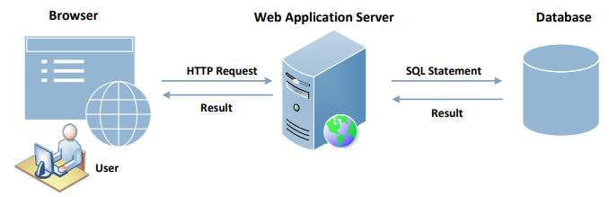
Interacting with Database in Web Application
A typical web application consists of three major components:
SQL (Structured Query Language) Injection attacks can cause damage to the database
As we notice in the figure, the users do not directly interact with the database but through a web server; If this channel is not implemented properly, malicious users can attack the database
104
Notes:
Explanation of the components:
Web Browser: Browser is on the client side, its primary function is to get content from the web server, present the content to the user, interact with the user and get the user inputs
Web Application server: They are responsible for generating and delivering content to the browser. They usually rely on an independent database server for data management
Browsers communicate with web servers using the Hypertext Transfer Protocol, while web servers interact with databases using database languages, such as SQL

Slide 105
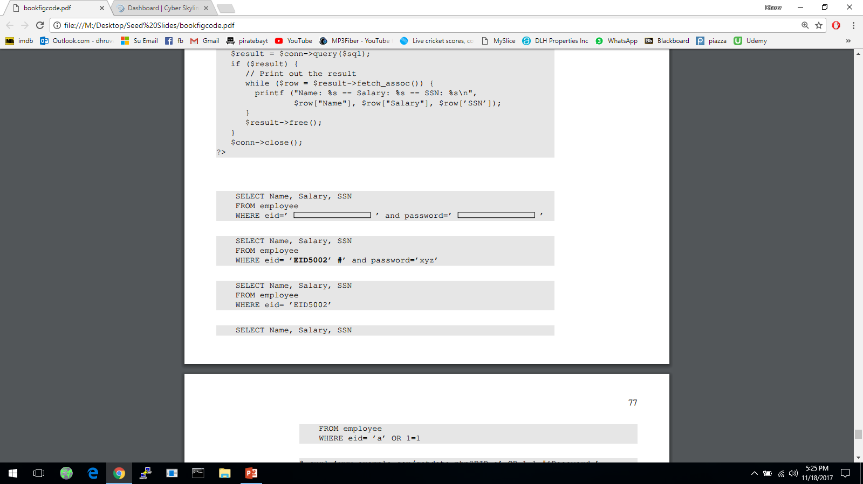
Launching SQL Injection Attacks
Everything provided by user will become part of the SQL statement (user data is mixed with web application code and given to the database); Is it possible for a user to change the meaning of the SQL statement?
The intention of the web app developer by the following is for the user to provide some data for the blank areas:
Assume that a user inputs a random string in the password entry and types “EID5002’#” in the eid entry; The SQL statement will become the following:
User is taking help of some special characters (e.g., # which will comment remainder of query i.e., the password check) to change the meaning of the SQL statement
105
Notes:
To understand possible attacks, we consider the abstract version of the web app creates a SQL statement template and a user needs to fill in the blanks inside the rectangle area.
The attack demonstrated shows the user taking help of some special characters to change the meaning of the SQL statement.

Slide 106

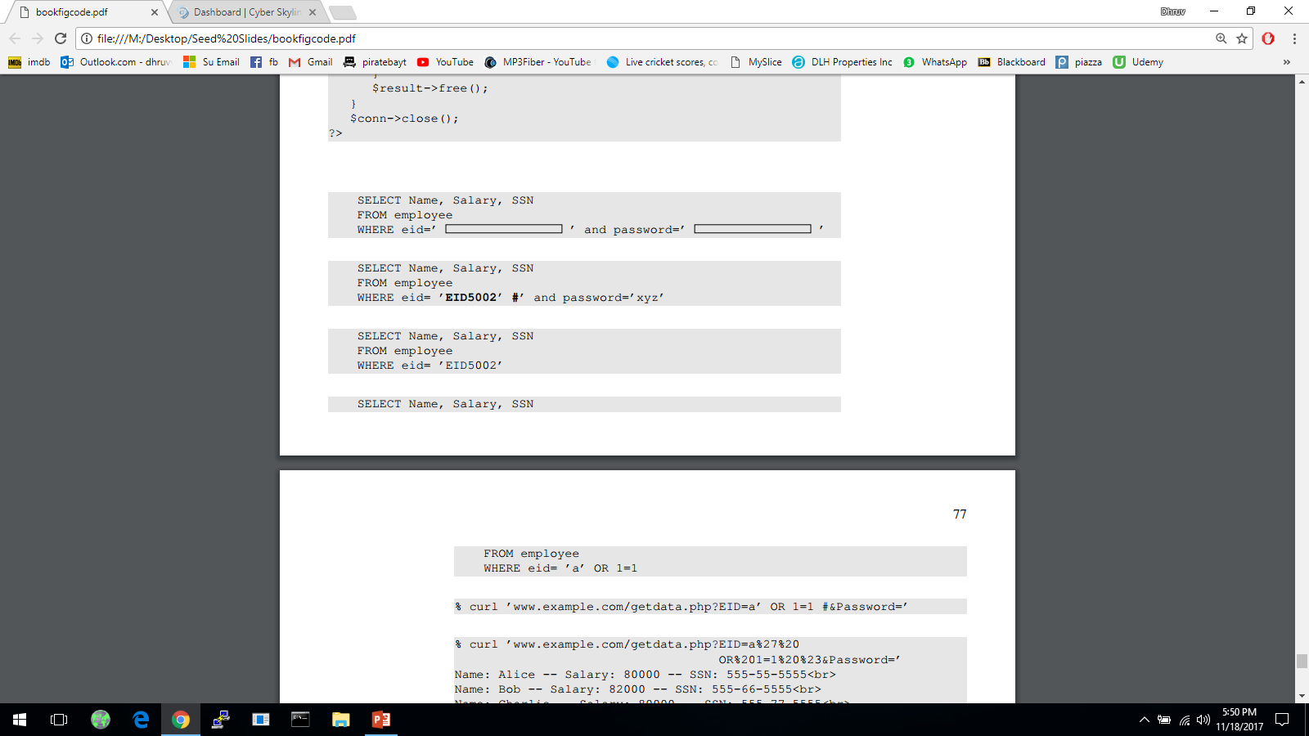
Launching SQL Injection Attacks
Everything from the # sign to the end of line is considered as comment; The SQL statement will be equivalent to the following:
The above statement will return the name, salary and SSN of the employee whose EID is EID5002 even though the user doesn’t know the employee’s password; This is a security breach
Let’s see if a user can get all the records from the database assuming that we don’t know all the EID’s in the database
We need to create a predicate for WHERE clause so that it is true for all records (i.e., ‘a’ is dummy that would not have any match, BUT we can add a true condition like “OR 1 =1” to match all the records)
106

Slide 107
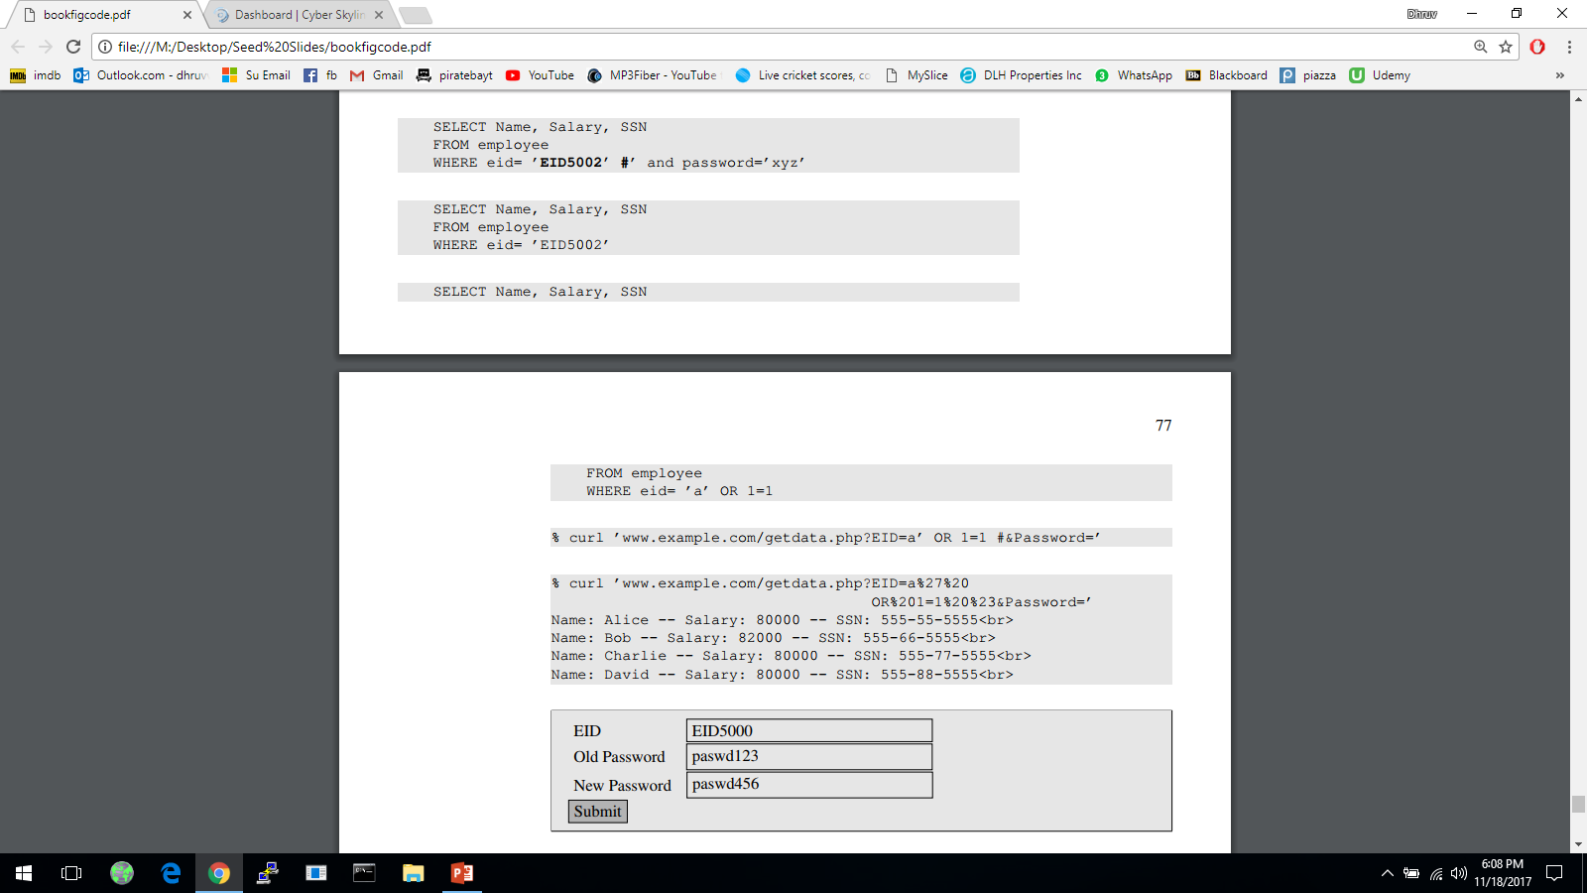

Launching SQL Injection Attacks using cURL
More convenient to use a command-line tool to launch attacks
Easier to automate attacks without a graphic user interface
Using cURL, we can send out a form from a command-line, instead of from a web page as follows:
The above command will not work; In an HTTP request, special characters are in the attached data needs to be encoded (with %20) or they maybe mis-interpreted
In the above URL we need to encode the apostrophe, whitespace and the # sign and the resulting cURL command is as shown below:
107
Notes:
In the previous section, we launch attacks using forms. Here we see how to perform those attacks using command-line tools.
cURL- widely used command-line tool for sending data over a number of network protocols, including HTTP and HTTPS.
URL syntax also uses some special characters so if the special characters attached to data is not encoded, it will be mis-interpreted.
Encoding for space is %20
Encoding for # is %23
Encoding for apostrophe is %27

Slide 108
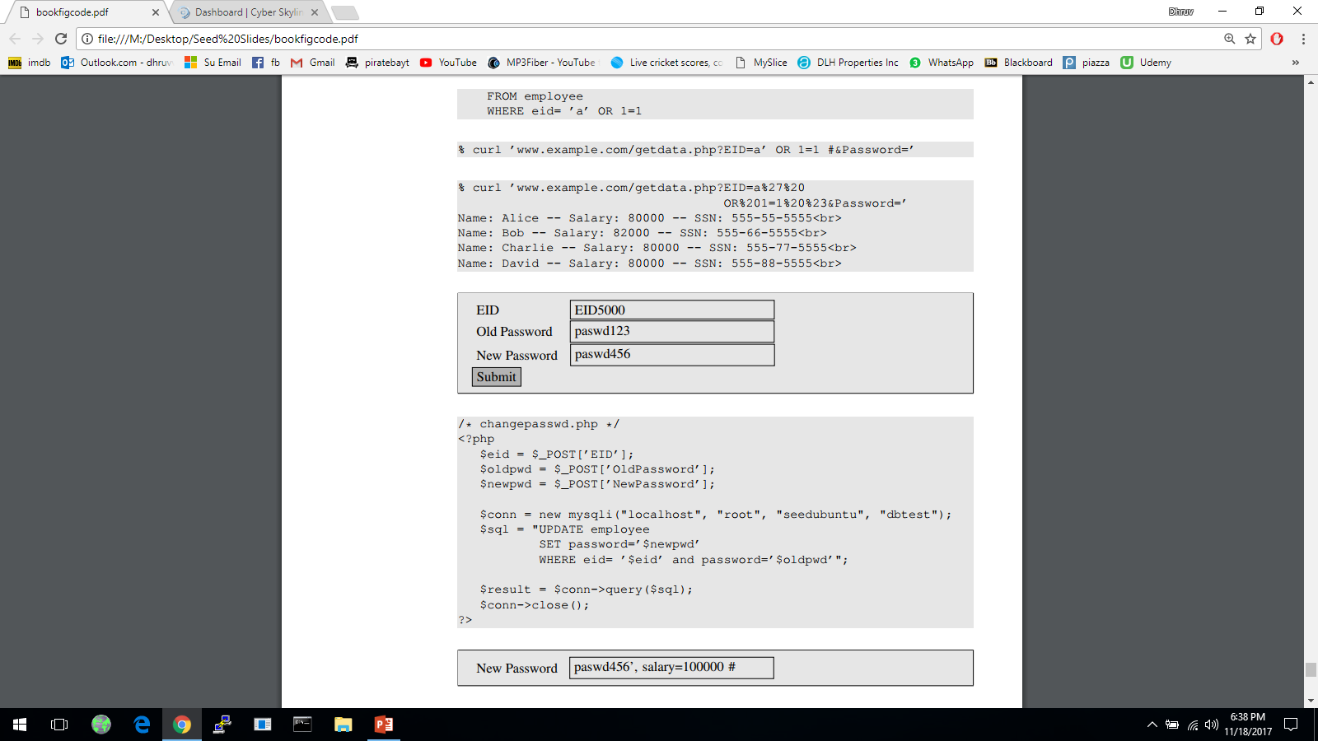
Modify Database
If the statement is UPDATE or INSERT INTO, we will have chance to change the database
Consider the form created for changing passwords; It asks users to fill in three pieces of information, EID, old password and new password
When Submit button is clicked, an HTTP POST request will be sent to the server-side script changepasswd.php, which uses an UPDATE statement to change the user’s password
108

Slide 109
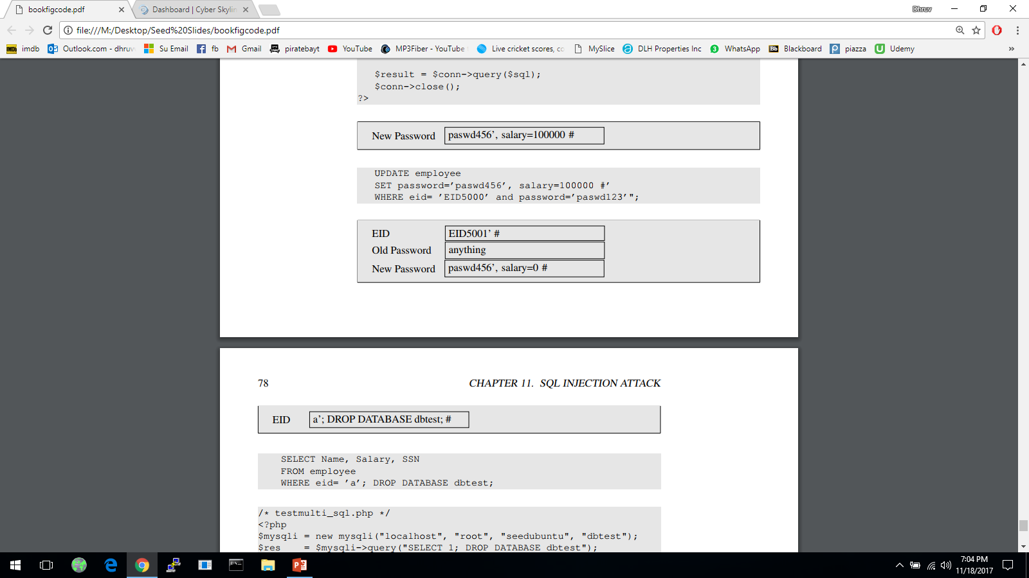


Modify Database
Due to SQL injection vulnerability, attackers can change other attributes (e.g., salary)
Let us assume that Alice (EID5000) is not satisfied with the salary she gets; She would like to increase her own salary using the SQL injection vulnerability; She would type her own EID and old password. The following will be typed into the “New Password” box:
By typing the above string in “New Password” box, we get the UPDATE statement to SET one more attribute for us, the salary attribute; The SQL statement will now look as follows:
What if Alice doesn’t like Bob and would like to reduce Bob’s salary to 0, but she only knows Bob’s EID (eid5001), not his password; How can she execute the attack?
109
Notes:
User inputs are used to construct the SQL statement, hence there is a SQL injection vulnerability.
A single UPDATE statement can set multiple attribute of a matching record, if a list of attributes, separated by commas, is given to the SET command.
The SQL statement in changepassword.php is meant to set only one attribute, the password attribute.
The intention of the PHP script is to change the password attribute. Due to SQL injection vulnerability, attackers can make changes to other attributes (here, salary).

Slide 110

Multiple SQL Statements
Damages that can be caused are bounded because we cannot change everything in the existing SQL statement
It will be more dangerous if we can cause the database to execute an arbitrary SQL statement
To append a new SQL statement “DROP DATABASE dbtest” to the existing SQL statement to delete the entire dbtest database, we can type the following in the EID box
The resulting SQL statement is equivalent to the following, where we have successfully appended a new SQL statement to the existing SQL statement string
The above attack doesn’t work against MySQL, because in PHP’s mysqli extension, the mysqli::query() API doesn’t allow multiple queries to run in the database server
110

Slide 111
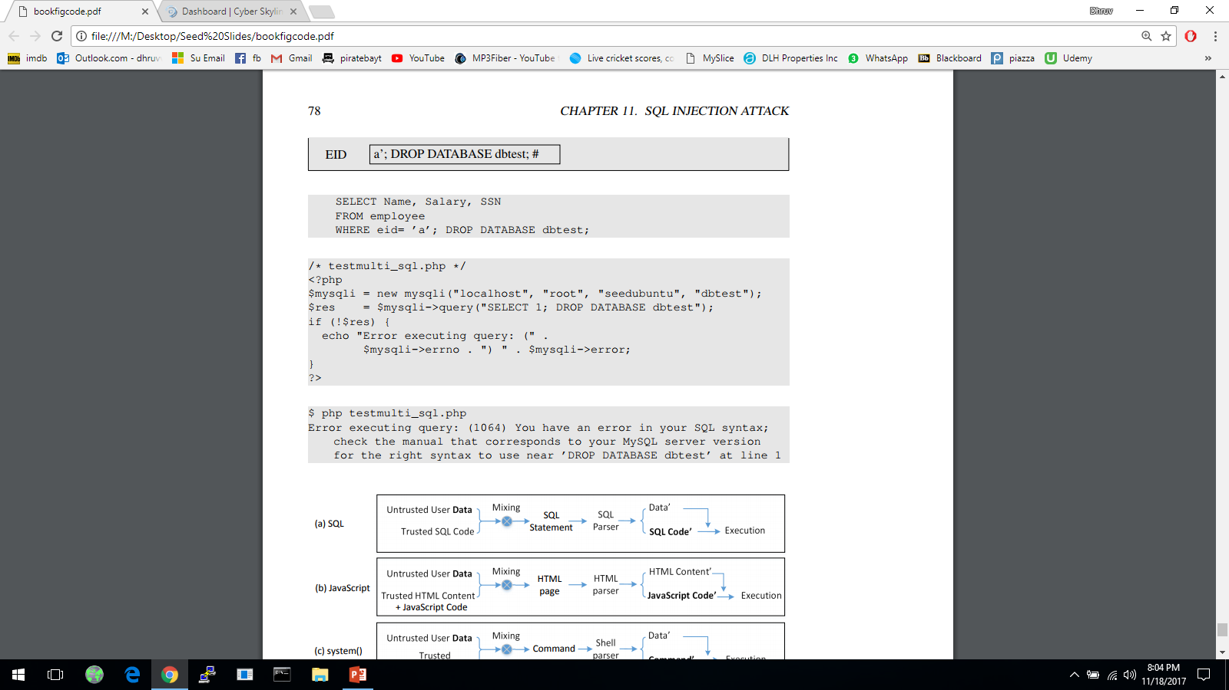
Multiple SQL Statements
The code below tries to execute two SQL statements using the $mysqli->query() API
When we run the code, we get the following error message:
If we do want to run multiple SQL statements, we can use $mysqli -> multi_query() [not recommended for security purposes]
111
Notes:
For the sake of security, we should avoid using the $mysqli->multi_query() API in codes, especially if the SQL statement string contains untrusted data.

Slide 112
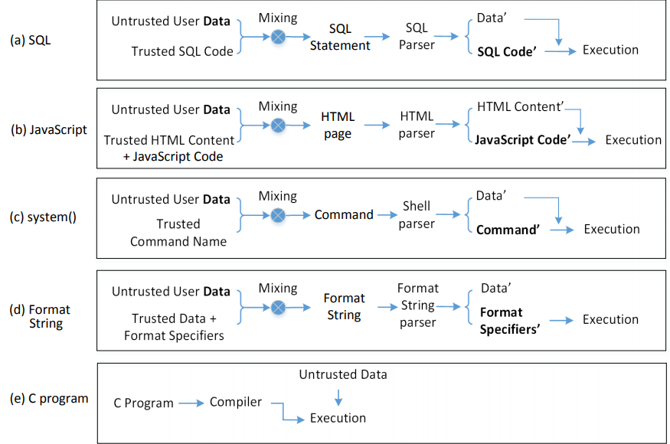
The Fundamental Cause
Mixing data and code together is the cause of several types of vulnerabilities and attacks including SQL Injection attack, XSS attack, attacks on the system() function and format string attacks
SQL Injection
Cross-Site Scripting
Shell Script Injection
112

Slide 113

Countermeasures: Filtering and Encoding Data
Before mixing user-provided data with code, inspect the data; Filter out any character that may be interpreted as code
Special characters are commonly used in SQL Injection attacks; To get rid of them, encode them
Encoding a special character tells parser to treat the encoded character as data and not as code; This can be seen in the following example
PHP’s mysqli extension has a built-in method called mysqli::real_escape_string(); It can be used to encode the characters that have special meanings in SQL
The following code snippet shows how to use this API
The filtering or escaping approach doesn’t address the fundamental cause of the problem; Data and code are still mixed together
113
Notes:
Characters that have special meaning in SQL statement and can be encoded, includes:
NULL (ASCII 0), carriage return (\r), newline (\n), backspace (\b), etc
The filtering or escaping approach doesn’t address the fundamental cause of the problem.
Data and code are still mixed together.
The approach makes code more secure.

Slide 114
Why Are Prepared Statements Secure?
Trusted code is sent via a code channel
Untrusted user-provided data is sent via data channel
Database clearly knows the boundary between code and data
Data received from the data channel is not parsed
Attacker can hide code in data, but the code will never be treated as code, so it will never be attacked
114

Slide 115
TCP fundamental
Attacks on the TCP protocol
Denial-of-Service attack
SQL injection attack
Cross-side scripting attack
Miscellaneous: Heartbleed bug and attack, Ransomware, Cryptojacking
Module 2

Slide 116
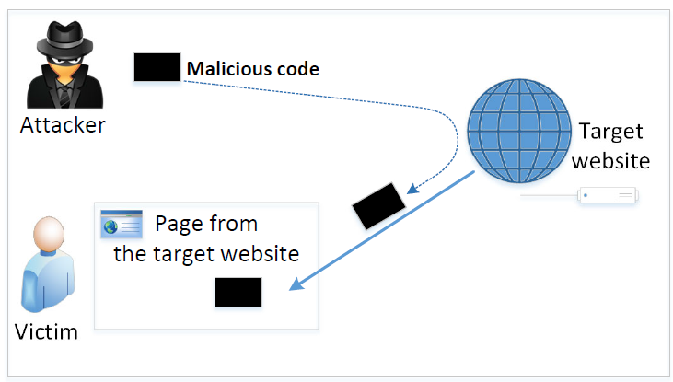
The Cross-Site Scripting Attack
In XSS, an attacker injects malicious code to the victim’s browser via the target website
When code comes from a website, it is considered as trusted with respect to the website, so it can access and change the content on the pages, read cookies belonging to the website and sending out requests on behalf of the user
Basically, code can do whatever the user can do inside the session
Types:
Non-persistent (Reflected) XSS Attack
Persistent (Stored) XSS Attack
116

Slide 117
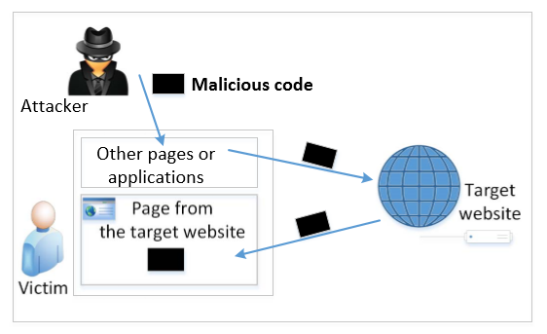
Non-persistent (Reflected) XSS Attack
Many websites take input from the user, conduct some activities and then send response to the user in a web page, with the original user input included on the response (i.e., the user input is reflected back)
E.g., Google search will give back your input and results
If a website with a reflective behaviour takes user inputs, then:
Attackers can put JavaScript code in the input, so when the input is reflected back, the JavaScript code will be injected into the web page from the website
117
Notes:
Attacker could put malicious code in Disk in old days, now with web – we use a website to inject the code
Many websites take input from the user, conduct some activities and then send response to the user in a web page, with the original user input included on the response (i.e the user input is reflected back)
“Convenience is the enemy of security” – HTML mixes data and code

Slide 118
Non-persistent (Reflected) XSS Attack
Assume a vulnerable service on website : http://www.example.com/search?input=word, where word is provided by the users
Now the attacker sends the following URL to the victim and tricks him to click the link: http://www.example.com/search?input=<script>alert(“attack”);</script>
Once the victim clicks on this link, an HTTP GET request will be sent to the www.example.com web server, which returns a page containing the search result, with the original input in the page
The input here is a JavaScript code which runs and gives a pop-up message on the victim’s browser
118

Slide 119
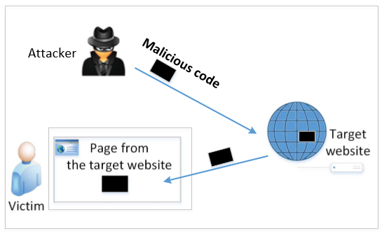
Persistent (Stored) XSS Attack
Attackers directly send their data to a target website/server which stores the data in a persistent storage
If the website later sends the stored data to other users, it creates a channel between the users and the attackers
Example: User profile in a social network is a channel as it is set by one user and viewed by another
119
Notes:
Same with Clinton/Obama site and the Samy Worm case i.e., they were persistent XSS attacks

Slide 120
Persistent (Stored) XSS Attack
These channels are supposed to be data channels
But data provided by users can contain HTML markups and JavaScript code
If the input is not sanitized properly by the website, it is sent to other users’ browsers through the channel and gets executed by the browsers
Browsers consider it like any other code coming from the website; Therefore, the code is given the same privileges as that from the website
120
Notes:
Session ID (SID) – we need to steal it, we send code to your computer through the social network platform that exchanges information flows; code steals your SID and attacker abuses

Slide 121
Countermeasures: The Filter Approach
Removes code from user inputs (corrects the mistake of mixing code and data together)
It is difficult to implement as there are many ways to embed code other than <script> tag
Use of open-source libraries that can filter out JavaScript code
Example: jsoup
121

Slide 122
Countermeasures: The Encoding Approach
Replaces HTML markups with alternate representations
If data containing JavaScript code is encoded before being sent to the browsers, the embedded JavaScript code will be displayed by browsers, not executed by them
Converts <script> alert(‘XSS’) </script> to &lt;script&gt;alert(‘XSS’)
122

Slide 123
Countermeasures: Using CSP
How websites tell browsers which code source is trustworthy is achieved using a security mechanism called Content Security Policy (CSP)
This mechanism is specifically designed to defeat XSS and ClickJacking attacks
CSP has become a standard, which is supported by most browsers nowadays
CSP not only restricts JavaScript code, it also restricts:
other page contents, such as limiting where pictures, audio, and video can come from
whether a page can be put inside an iframe or not (used for defeating ClickJacking attacks)
123

Slide 124
In-Class Practices
Question 1: In order to implement the classic DoS flood attack, the attacker must generate a sufficiently large volume of packets to exceed the capacity of the link to the target organization. Consider an attack using ICMP echo request (ping) packets that are 500 bytes in size (ignoring framing overhead). How many of these packets per second must the attacker send to flood a target organization using a 0.5-Mbps link? How many per second if the attacker uses a 2-Mbps link? Or a10-Mbps link?

Slide 125
Answers to Q1
Let’s have the following parameters: w the bandwidth of the communications channel, and p the minimum number of 500-byte size packets needed to exceed the capacity of the channel. To reach the capacity of the channel (p * 500 * 8) = w, with w expressed in bits, so p = w/4000. Based on it for each case we have:
w = 0.5 Mbps = 500,000 bits; p = 500000/4000 = 125 packets/second
w = 2.0 Mbps = 2,000,000 bits; p = 2000000/4000 = 500 packets/second
w = 10.0 Mbps = 10,000,000 bits; p = 10000000/4000 = 2,500 packets/second

Slide 126
In-Class Practice
Question 2: Consider a distributed variant of the attack we explore in Problem Q1. Assume the attacker has compromised a number of broadband-connected residential PCs to use as zombie systems. Also assume each such system has an average uplink capacity of 128 kbps. What is the maximum number of 500-byte ICMP echo request (ping) packets a single zombie PC can send per second? How many such zombie systems would the attacker need to flood a target organization using a 0.5-Mbps link? A 2-Mbps link? Or a10-Mbps link? Given reports of botnets composed of many thousands of zombie systems, what can you conclude about their controller’s ability to launch DDoS attacks on multiple such organizations simultaneously? Or on a major organization with multiple, much larger network links than we have considered in these problems?

Slide 127
Answers to Q2
Let’s have the following parameters: w the bandwidth of the communications channel, and p the minimum number of 500-byte size packets needed to exceed the capacity of the channel, and z the number of zombies needed to exceed the capacity of the channel. The maximum number of packets a zombie can send is p_{z} = 128,000/4000 =32 pps (packets per second). Based on the results from Q2, the number of required zombies will be z = p/p_{z} = p/32, and for each case we have:
w = 0.5 Mbps; z = 125pps/32pps = 3,9 (requires 4 zombies)
w = 2.0 Mbps; z = 500pps/32pps = 15,6 (requires 16 zombies)
w = 10.0 Mbps; z = 2500pps/32pps = 78,1 (requires 79 zombies)
Based on the results we got above, it suggests that just a few zombies with relatively low capacity communication channel will be able to cause problems to organizations. In the examples above, with corporate bandwidth from 0.5Mbps to 10Mbps, we have a very narrow channel for today’s standards, however the number of zombies required to shut those networks down is small compared with the thousands of zombies that a botnet controller could use. With thousands of zombies conducting flooding DoS attacks, a botnet controller will be able to attack many organizations at the same time or a big organization with multiple links. If the botnet controller manages to increase the size of the packet the attack will be even more effective.

Slide 128
In-Class Practices
Question 3: All the information that a server needs to know about a connection is not only contained in the SYN packet, but also in the final ACK packet from the client. Therefore, information-wise, there is no need to allocate a buffer to save the information about half-open connections. If we get rid of this buffer, the SYN flooding attack will not be effective any more. Do you agree with such a statement or not. Please justify your answer.

Slide 129
Answers to Q3
Basically, if we get rid of the buffer, we have solved the SYN flooding attack problem, but we will introduce a new and more powerful attack. The attacker can simply send ACK flooding packets, each one causing the server to allocate memory for a full connection, which takes more memory than that for half-open connections.

Slide 130
TCP fundamental
Attacks on the TCP protocol
Denial-of-Service attack
SQL injection attack
Cross-side scripting attack
Miscellaneous: Heartbleed bug and attack, Ransomware, Cryptojacking
Module 2

Slide 131

The Heartbleed Bug and Attack
Vulnerability in the OpenSSL library, specifically the Heartbeat protocol in TLS (Transport Layer Security)
OpenSSL (widely used library for TLS) drives HTTPS that your web browser relies on for online banking, and other secure transactions
Launched in 2012 on web servers built on top of OpenSSL
Disclosed in 2014
131
Notes:
OpenSSL is a commercial grade toolkit for the TLS/SSL protocols
Many secure web servers are built on top of OpenSSL.
When a client and server are not sending data to each other for a period of time, either side or firewall in between may break the channel.
The protocol:
The sender send a Heartbeat packet to receiver.
Inside the packet there is payload, payload length field. (Actual content of payload is not important)
The receiver constructs a response packet and should carry same payload data as in request.
When the receiver gets a heartbeat request, it retrieves payload length value (n) from the packet, copies n bytes of data to the response packet, starting from the beginning of the payload field in the request packet.

Slide 132
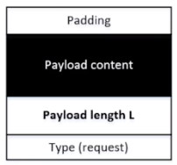
Background: the Heartbeat Protocol
TLS/SSL protocols provide a secure channel between two communicating applications
Heartbeat extension: implement keep-alive feature of TLS
Maintains secure session without interruption (e.g., from firewall) when client and server are not sending data to each other for a period of time
Hard to initiate and re-establish secure sessions
Send request packet to receiver and obtain an acknowledgement packet by doing a copy of the payload content based on payload length L
The copy caused the vulnerability; attacker can specify larger L
Heartbleed bug is an implementation flaw in TLS/SSL heartbeat extension
132
Notes:
OpenSSL is a commercial grade toolkit for the TLS/SSL protocols
Many secure web servers are built on top of OpenSSL.
When a client and server are not sending data to each other for a period of time, either side or firewall in between may break the channel.
The protocol:
The sender send a Heartbeat packet to receiver.
Inside the packet there is payload, payload length field. (Actual content of payload is not important)
The receiver constructs a response packet and should carry same payload data as in request.
When the receiver gets a heartbeat request, it retrieves payload length value (n) from the packet, copies n bytes of data to the response packet, starting from the beginning of the payload field in the request packet.

Slide 133
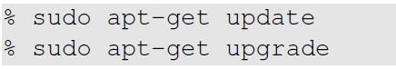
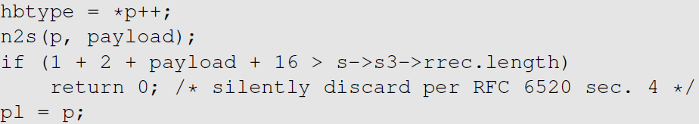
Fixing the Heartbleed Bug
Simply update your system’s OpenSSL library. The following two commands can be used for it:
The following code shows how the OpenSSL library is fixed
133
Notes:
Comparing the shown code with the vulnerable version shown earlier,
An if statement is added
s -> s3 -> rrec.length is the total number of bytes in the request packet; this is the actual length and not the one declared in the request packet.
Constant 1 -> size of type field
Constant 2 -> size of length field
Constant 16 -> minimum padding length
The if statement compares whether the declared payload length plus a constant (19) is larger than the actual size of the request packet.
If larger, the packet is discarded and there will be no reply.
If attacker send a request packet with larger declared length value, the packet won’t have any effect.

Slide 134
Fixing the Heartbleed Bug – Use Bounds Checking
Comparing the shown code with the vulnerable version shown earlier,
An if statement is added
s → s3 → rrec.length is the total number of bytes in the request packet; this is the actual length and not the one declared in the request packet
Constant 1 → size of type field
Constant 2 → size of length field
Constant 16 → minimum padding length
The if statement compares whether the declared payload length plus a constant (19) is larger than the actual size of the request packet
If larger, the packet is discarded and there will be no reply
If attacker send a request packet with larger declared length value, the packet won’t have any effect
Story: Bounds Checking and Game Design
134
Notes:
Comparing the shown code with the vulnerable version shown earlier,
An if statement is added
s -> s3 -> rrec.length is the total number of bytes in the request packet; this is the actual length and not the one declared in the request packet.
Constant 1 -> size of type field
Constant 2 -> size of length field
Constant 16 -> minimum padding length
The if statement compares whether the declared payload length plus a constant (19) is larger than the actual size of the request packet.
If larger, the packet is discarded and there will be no reply.
If attacker send a request packet with larger declared length value, the packet won’t have any effect.

Slide 135
Cryptojacking
Cryptojacking is the unauthorized use (i.e., hijacking) of someone else’s computer processing power to mine cryptocurrency
Hackers do this by either:
Social Engineering / Malware: Getting the victim to click on a malicious link (phishing) in an email that loads cryptomining code (malware) on the computer, or
Browser-based Attacks: By infecting a website or online ad with JavaScript code that auto-executes once loaded in the victim’s browser (mining will take place as long as browser/tab is open)
Either way, the cryptomining code then works in the background as unsuspecting victims use their computers normally
Symptoms: overheating of device, high processor usage, slower performance or lags in execution
135

Slide 136
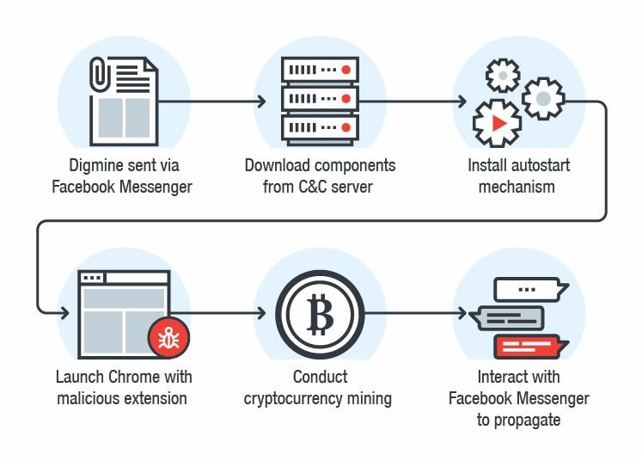
How Cryptojacking Works
Hackers inject a cryptomining script on a website or in an Ad that is placed on multiple sites
When the victim visits the infected website, or if the malicious Ad pops up in the victim’s browser, the script automatically executes
No code is stored on the victim’s computer and no damage is done to computers or victims’ data
Interaction with mining pool
136
Notes:
C&C server : Command and Control server: a computer controlled by an attacker or cybercriminal which is used to send commands to systems compromised by malware and receive stolen data from a target network.

Slide 137
Prevention of Cryptojacking
Use VPN to encrypt internet connections and hide IP address
Awareness and Training to thwart social engineering scams
Install an Ad-blocking or anti-cryptomining extension on web browsers
Use end-point protection that is capable of detecting known crypto miners
Keep your web filtering tools up to date
Maintain browser extensions
Use a mobile device management (MDM) solution to better control what’s on users’ devices
137

Slide 138
DNS and Attacks
DNS Hierarchy, Zones, and Servers
DNS Query Process
DNS Attacks: Overview
Local DNS Cache Poisoning Attack
Defense against DNS spoofing attacks
138

Slide 139
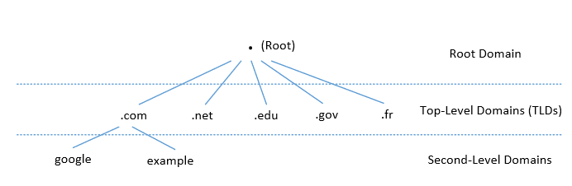
DNS Domain Hierarchy
Domain Name System (DNS) is a phonebook of the Internet – enables mapping of domain names to IP addresses of machines
Domain (nameserver) namespace is organized in a hierarchical tree-like structure
Each node is called a domain, or subdomain.
The root of the domain is called ROOT, denoted as ‘ . ‘
Internet Assigned Name Authority (IANA)
Below ROOT, we have Top-Level Domain (TLD). Ex: In www.example.com, the TLD is .com
The next level of domain hierarchy is second-level domain which are usually assigned to specific entities such as companies, schools etc.
139

Slide 140
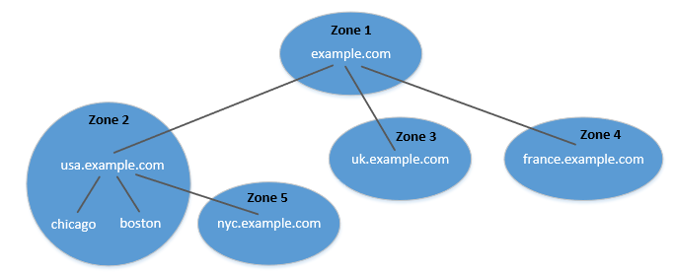
DNS Zone
DNS is organized according to zones
A zone groups contiguous domains and subdomains on the domain tree and assign management authority to an entity
usa.example.com is a domain with subdomains as boston, nyc and chicago; Two zones are created for usa.example.com - First contains usa domain, chicago and boston subdomain and second contains nyc subdomain
Hierarchy tree structure depicts subdomains within example.com domain
In this case, there are multiple DNS zones one for each country; the zone keeps records of who the management authority is for each of its subdomains
For scalability, you have sub-domains on different name servers
140
Notes:
1 zone – if one domain on one nameserver; but in many situations if domain is big and you don’t want to host all on one name server, you can have sub-domains on different name servers – then you have different zones with subsets of sub-domains on different nameservers

Slide 141
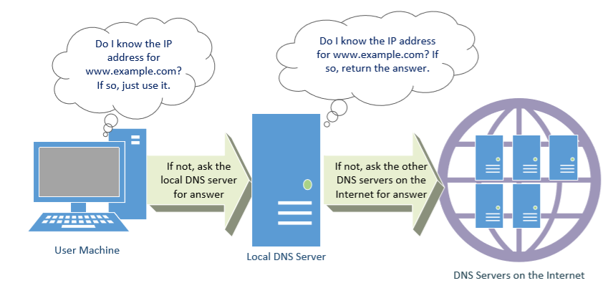
DNS Query Process
DNS Cache
.com
Local DNS Files
Recursive
141
Notes:
DNS query is recursive – keep asking till you find the answer; Let’s ask example.com – talk to com server who has registered the nameserver for the example.com; if you ask that nameserver, if big – then it tell you which sub-domain

Slide 142
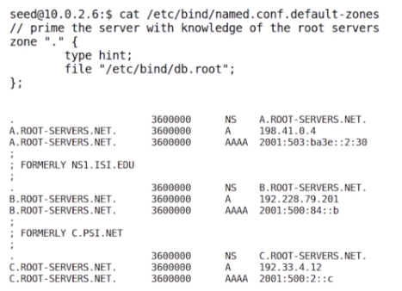
DNS cache
When the local DNS server gets information from other DNS servers, it caches the information
Each piece of information in the cache has a time-to-live value, so it will be eventually time out and removed from the cache
Question: How local DNS server get’s root server IP?
Answer: The Zone file
142

Slide 143
DNS Attacks
Denial-of-Service Attacks (DoS): When the local DNS servers and the authoritative nameservers do not respond to the DNS queries, the machines cannot retrieve IP addresses which essentially cuts down the communication
DNS Spoofing Attacks:
Primary goal: provide a fraudulent IP address to victims, tricking them to communicate with a machine that is different from their intention
Example: If a user’s intention is to visit a bank’s web site to do online banking, but the IP address obtained through the DNS process is attacker’s machine, the user machine will communicate to the attacker’s web server
143

Slide 144
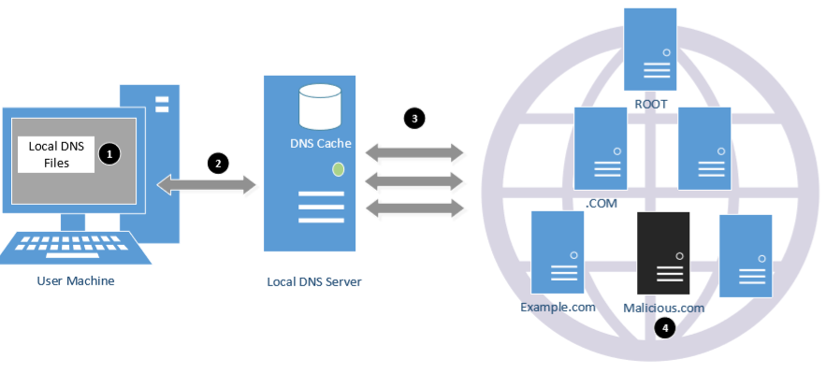
Overview of the Attack Surfaces
DNS queries involve several packets and thus present a broad attack surface in terms of spoofing (1 – 4 in figure below)
/etc/hosts file
with localhost information
You can also launch DoS attack at all points – root, local DNS server, TLD server
144

Slide 145
DNS Attacks on Compromised Machines
If attackers have gained the root privileges on a machine,
Modify /etc/resolv.conf: use malicious DNS server as the machine’s local DNS server and can control the entire DNS process
Modify /etc/hosts: add new records to the file, providing the IP addresses for some selected domains
For example, attackers can modify IP address of www.bank32.com which can lead to attacker’s machine
145

Slide 146
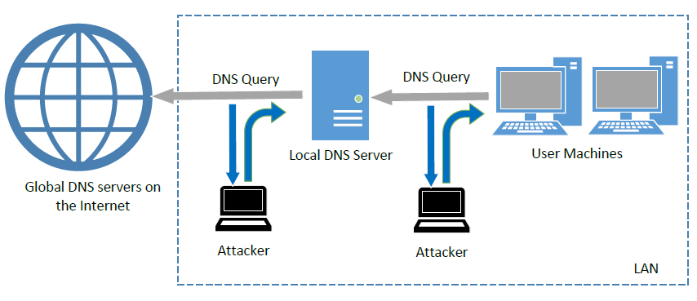
Spoofing DNS Replies (from LAN)
Attacks on user machines : When the user machine sends out a DNS query to its local DNS server, attacker can immediately send a spoofed reply, using local DNS as its source IP address; Attackers can put any arbitrary IP address in the reply
Attacks on local DNS server : Cache Poisoning attack : When the local DNS server sends out iterative queries to get an answer from the DNS servers on the Internet, attackers can send out spoofed replies to the local DNS server; They get accepted as long as they arrive before the actual replies - This is called DNS cache poisoning
146
Notes:
Attacks on user machines : When the user machine sends out a DNS query to its local DNS server, attacker can immediately send a spoofed reply, using local DNS as its source IP address. Attackers can put any arbitrary IP address in the reply.
Attacks on local DNS server : Cache Poisoning attack : When the local DNS server sends out iterative queries to get an answer from the DNS servers on the Internet, attackers can send out spoofed replies to the local DNS server. They get accepted as long as they arrive before the actual replies. This is called DNS cache poisoning.

Slide 147
Security architectures
Moving target defense, Defense by pretense
Anomaly detection
Threat intelligence collection
Penetration testing
Risk assessment and management
Module-3: Discussion Topics

Slide 148
Security architectures
Moving target defense, Defense by pretense
Anomaly detection
Threat intelligence collection
Penetration testing
Risk assessment and management
Module-3: Discussion Topics

Slide 149








Critical Application Infrastructures
Consumer Apps
Online Retail
Health Care
Cloud Computing
And Networking
Advanced
Manufacturing
Gaming
Very large user bases, and web services that benefit societal needs

Slide 150
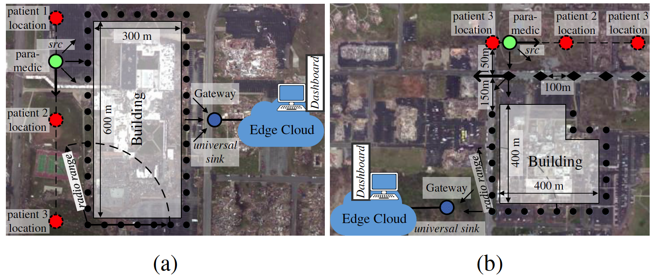
Lightweight and Flexible Security for IoT-based Public Safety Applications
Recreated disaster scenes of tornado damages (in Joplin, MO 2011) at the: (a) Joplin High School; (b) Joplin Hospital
150

Slide 151
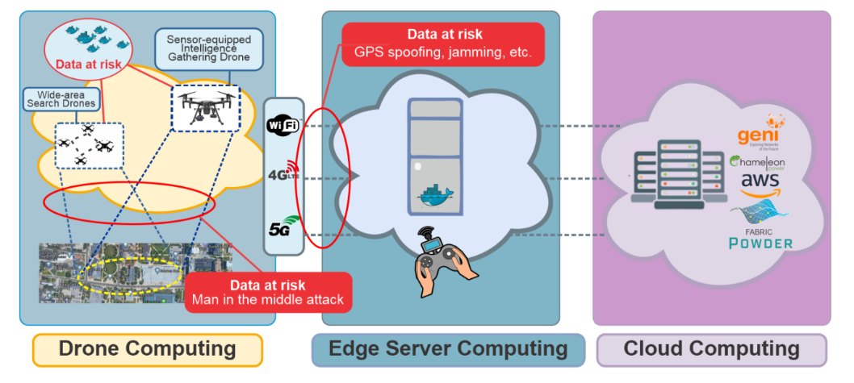
Lightweight and Flexible Security for IoT-based Public Safety Applications
IoT Gateway Middleware that uses machine learning to decide on tradeoffs in energy, latency and security in deciding computing policies at core or edge
A. Esquivel, D. Kavzak Ufuktepe, R. Ignatowicz, A. Riddle, C. Qu, P. Calyam, K. Palaniappan, “Enhancing Network-edge Connectivity and Computation Security in Drone Video Analytics”, IEEE Applied Imagery Pattern Recognition (AIPR) Workshop, 2020.
151

Slide 152
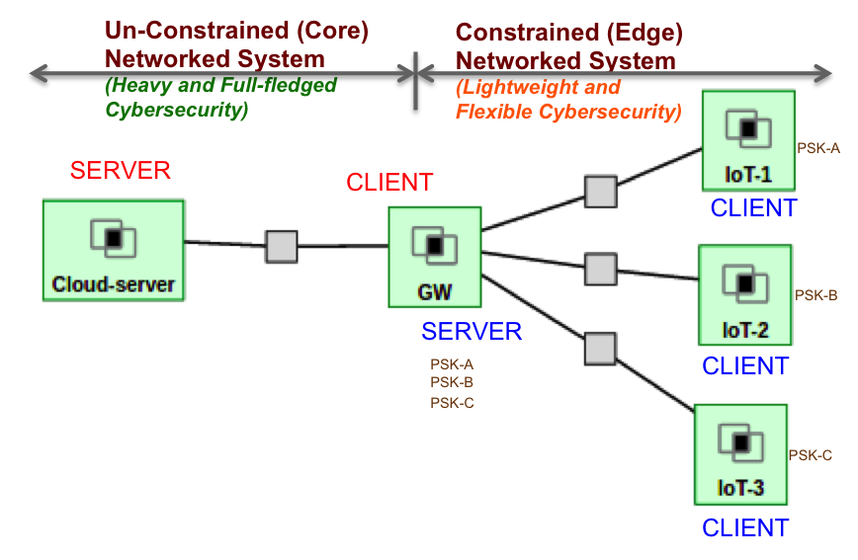
Lightweight and Flexible Security for IoT-based Public Safety Applications
IoT Gateway Middleware that uses machine learning to decide on tradeoffs in energy, latency and security in deciding computing policies at core or edge
Details in Module 4…
152

Slide 153



Media Application: Just-in-time News Feeds
Recent shift in news related media consumption trends
Readers are relying on 'just-in-time news feeds' versus the traditional print medium
Media companies are offering ‘just-in-time news’ feed service for their subscribers who pay money for ‘premium’ content
Particularly popular in sectors such as Finance and Health Care
153

Slide 154
Media Application: Anomaly Detection
Used to detect anomalies occurring in a network path or server
Requires collection of profiles or signatures that represent the normal and abnormal behavior
E.g., number of failed login attempts permissible/occurred for a host, the level of processor usage, and consumed network bandwidth
Email threshold
Bandwidth threshold
Audit Data
Learning engine
Login fail
threshold
CPU usage
threshold
Training period
Profile
alarm
Activity data
Detect engine
pass
Detecting period
154

Slide 155
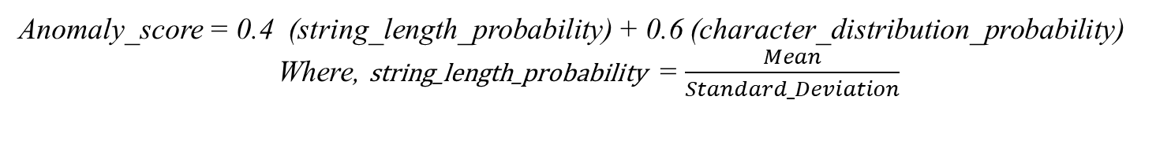
Media Application: Anomaly Detection
“URL Anomaly Detection” checks the abnormality of a URL through detection of the deviation of the character distribution in the received URL string
Training Phase:
Here, the data is trained using some sample URLs
From the URLs, an ASCII map count of each character is generated. This count is used in the Anomaly Detection phase to calculate the String Length Probability and Character Distribution Frequency Probability
Detection Phase:
This phase calculates the Anomaly value for a given input URL
The Character Frequency Distribution uses Histogram model to calculate the Frequency Distribution of each character in the given input URL string
The Anomaly Score is calculated as -
Anomaly_score = 0.4 (string_length_probability) + 0.6 (character_distribution_probability)
Where, string_length_probability = $\frac{Mean}{Standard_Deviation}$
155

Slide 156
Manufacturing Application Security & Privacy
“Agile manufacturing” builds on the benefits of cloud computing (e.g., businesses
Don’t need to invest and manage expensive computing resources or computational solver licenses)
Need to bridge the collaboration gap between Manufacturing App Developer and a Cloud Engineer in “Manufacturing App Marketplaces”
Or AWS, GCP, …
156

Slide 157
Manufacturing App Marketplace Security Architecture
How to secure on-going efforts to scale-up the App Marketplace with user opt-in via a new web-access layer features?
(a) an integrated single sign-on authentication
(b) on-demand/secure access to run virtual desktops, and virtual machines for web servers to host the various Apps
(c) secure storage of results after the computation stages to protect intellectual property of the manufacturers’ App designs and data sets
(d) Defense against LoC using HoneyFiles (Defense by Pretense)
157

Slide 158
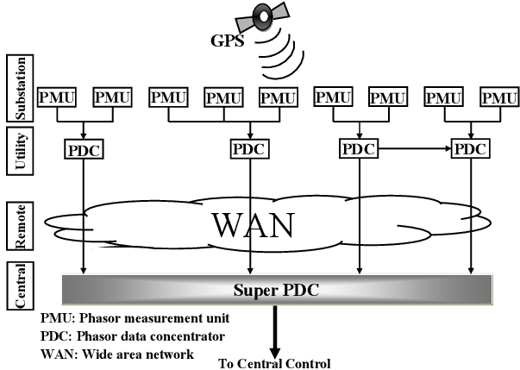
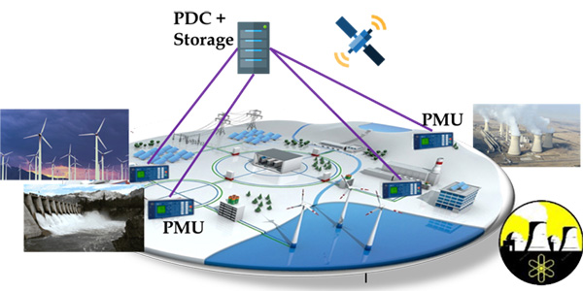
SmartGrid Application
Wide-area measurement and control systems (WAMCS) technology using Phasor Measurement Units (PMUs) is important
Helps guarantee resilience, stability, reliability, state estimation, control, and protection of next-generation power systems
However, there is an exponentially increasing number of PMUs and PDCs being deployed in the North American grid
Result is an explosion in data volume, which needs an efficient wide-area communication and computing infrastructure
158

Slide 159
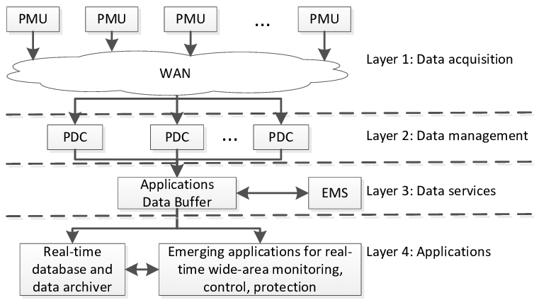
SmartGrid Application
As an example for power grids, according to UCAlug Open Smart Grid, every PMU (from a utility company) requires 600 to 1500 Kbps bandwidth, 20 ms to 200 ms latency, almost 100% reliability, and a 24-hour backup
WAMCS will require cloud computing resources (e.g., storage) and Gigabit per second bandwidth for satisfactory performance and resilience
Challenges are even more aggravated by the gradual transition from centralized to distributed systems for increased speed of data processing
With SDN
Privacy and Non-disclosure issues
159

Slide 160
SmartGrid Security Architecture
How to secure on-going efforts to store and process PMU data with utility companies opt-in via a new web-access layer and software-defined network features?
(a) an integrated single sign-on authentication
(b) on-demand/secure access to computation in the cloud to calculate e.g., secure state estimates in the power grids
(c) secure storage of results after the computation stages to protect intellectual property of the utility company’s data sets
(d) Defense against LoC attacks using Role-based Access Control
160

Slide 161
Security and challenges in Collaborative Drone Systems
The use of these systems has been increasing and the issues related to security, privacy, reliability, regulation, and ownership are also increasing at the same pace [5].
Furthermore, collaborative drone systems are usually resource-constrained, in addition to being highly vulnerable to physical and cyber attacks/threats.
Challenges exist to secure the communication in collaborative drone services in terms of privacy leakage, data confidentiality protection, and the lack of development and implementation of mechanisms for reliable and secure protocols [6].
[5] Hassija, V., Chamola, V., Agrawal, A., Goyal, A., Luong, N.C., Niyato, D., Yu, F., & Guizani, M. (2021). Fast, Reliable, and Secure Drone Communication: A Comprehensive Survey.
[6] C. Lin, D. He, N. Kumar, K. R. Choo, A. Vinel, X. Huang, "Security and Privacy for the Internet of Drones: Challenges and Solutions", IEEE Communications Magazine, Vol. 56, no. 1, pp. 64-69, 2018.

Slide 162
Attacks on Drones
Attack Vectors
How these attacks are performed
DoS
Throughput is decreased. The communication between UAVs and the GCS is slowed and eventually, it will go out of service.
The attacker changes the GPS location information in the packets causing the target UAV to change its target destination (sending information to another agents, or making it crush to an entity)
MITM
Black Hole
This malicious node begins to beacon with the other UAVs in the swarm, and show high levels of energy, consistent on the protocol activity, causing the UAV to run out of energy before reaching the destination or accomplishing the task.

Slide 163
Zero Trust – One way to solve all
Modeling threats that focus on
Zero Trust - Defense Mechanisms
Check for a maliciously high data rate of packers from any UAVs in the network. If a drone is found to be send packets at a rate greater than the threshold, the node is blacklisted from the network and the updated blacklist will be sent to the remaining drones in the network.
Compares the energy levels of the drones in the network with a predetermined energy threshold based on the known energy capabilities of the UAV. If the energy level of a UAV is greater than the threshold, then the node is blacklisted from the network.
Apply message authentication by using a hash value for each packet and an algorithm to enforce policies if the message integrity is violated.
Detection
Prevention
Mitigation

Slide 164
That’s it! Good Luck!
Exam Date: Mon, Feb. 26th

